Slide 1
Exploiting Dynamic Phase Distance Mapping for Phase-based Tuning of Embedded Systems
Tosiron Adegbija and Ann Gordon-Ross⁺
Department of Electrical and Computer Engineering
University of Florida, Gainesville, Florida, USA
⁺ Also Affiliated with NSF Center for High-Performance Reconfigurable Computing
This work was supported by National Science Foundation (NSF) grant CNS-0953447

Slide 2
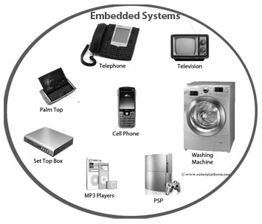
Introduction and Motivation
Embedded systems are pervasive and have stringent design constraints
Constraints: Energy, size, real time, cost, etc
System optimization is challenging due to numerous tunable parameters
Tunable parameters: parameters that can be changed
E.g., cache size, associativity, line size, clock frequency, etc
Many combinations ➔ large design space
Phase-based tuning increases optimization potential
How to determine a phase’s best configuration without significant runtime overhead?

Slide 3
Previous Work: Phase Distance Mapping (PDM)
Previously characterized phase
New phase
Base phase
Phase P_{i}
Cache characteristics | Cache configuration
P_{b} | C_{b}
Cache characteristics | Cache configuration
P_{i}
?
Statically defined
phase distance
ranges
d (P_{b}, P_{i})
Phase distance
Distance windows
Configuration
change from
base phase’s
configuration
Configuration distance

Slide 4
Phase Distance Mapping (PDM)
PDM’s limitations
Statically defined
Needed to know/analyze
applications a priori
Unknown applications/
general purpose systems?
Distance windows
Design time overhead!!!
Base phase
Most prominent application
domain

Slide 5
Contributions
DynaPDM: Dynamic Phase Distance Mapping
Dynamically defined at runtime
Adapts to runtime application changes
No need to know/analyze
applications a priori
Suitable for unknown applications/
general purpose systems
Distance windows
Low overhead dynamic
method for determining a
phase’s best configuration!
Design time overhead!!!
Base phase
Dynamically determined
Most prominent application
domain

Slide 6
Results
DynaPDM’s
configurations
1% of
the optimal!
47%
28%
EDP savings calculated with respect to the base configuration
DynaPDM achieved 28% average EDP savings overall
Savings as high as 47% for 64M-rotatew2
On average, within 1% of the optimal
EDP improved over PDM by 8%
DynaPDM improved over PDM and eliminated design-time effort!

