Slide 1
Proactively Enhancing STEM Diversity
Ann Gordon-Ross
Associate Professor Department of Electrical and Computer Engineering
University of Florida

Slide 2
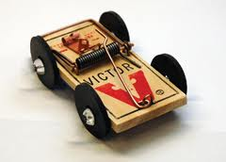
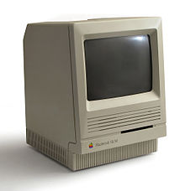
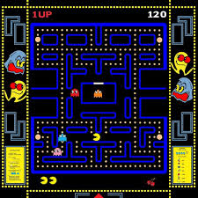
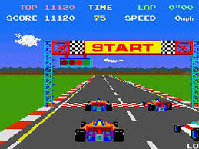
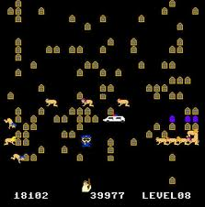
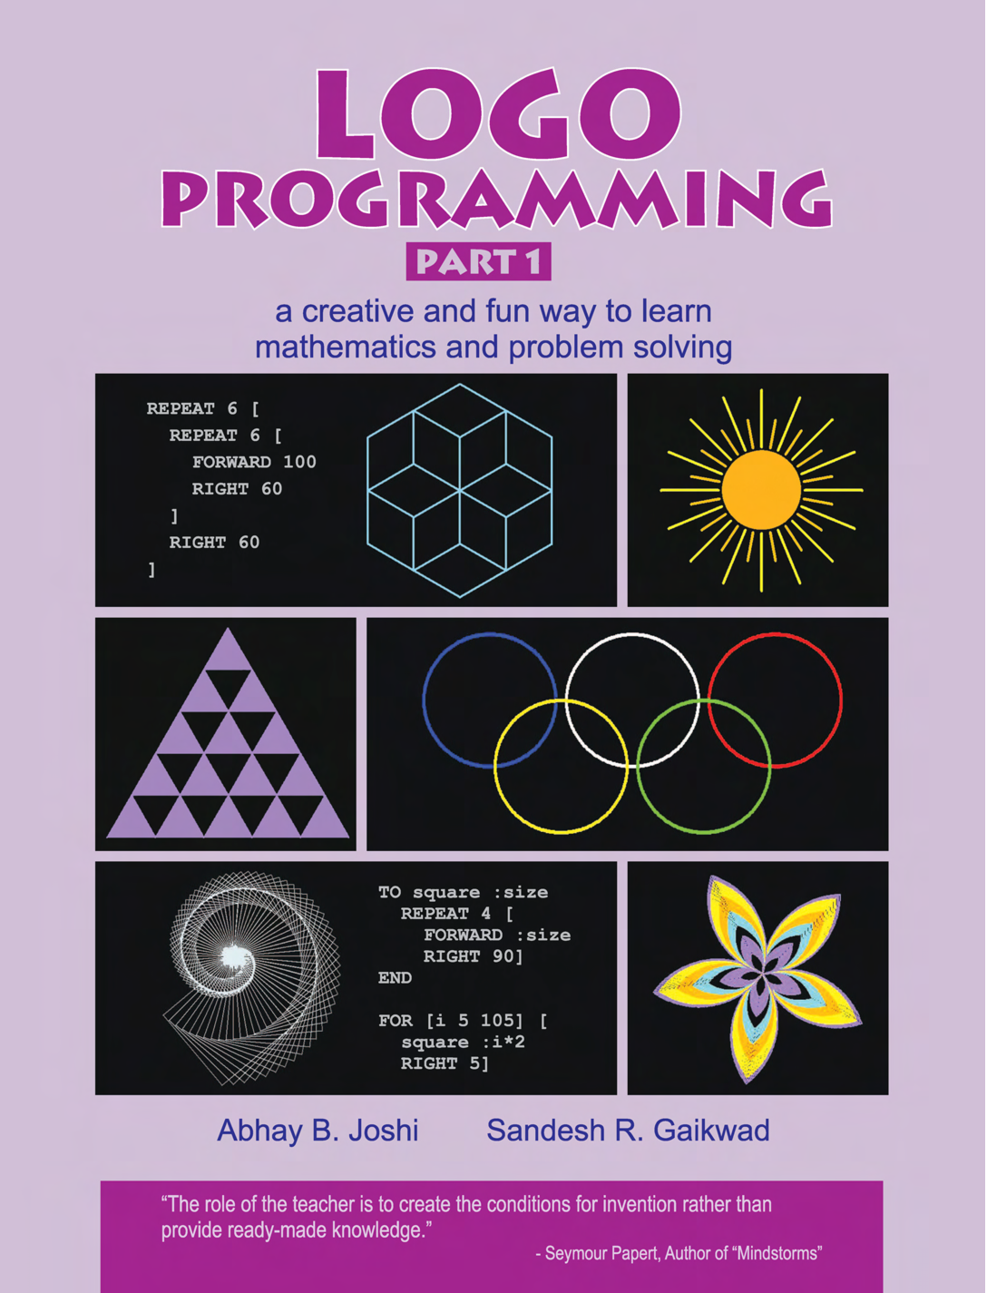
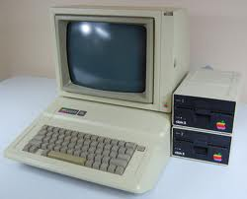
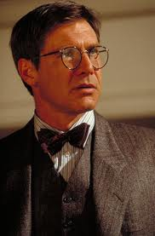
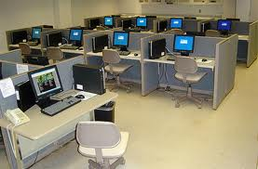
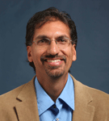
Accidental Path to Academia
Logo
Basic
forward 50
right 90
forward 50
High School
Programming course
Advanced placement
Math and science
*
$80k/year job?
Ph.D.?
M.S.?
B.S.
Graduate school?
* But I never wanted to be a teacher!

Slide 3
Reality of Career Paths
Career paths can be accidental, but my experience is not typical
I have never been a “woman in a STEM field”
I am a “researcher in a STEM field”
But not the reality for everyone
Individuals tend to follow *standard* career paths based on
Heritage, family tradition, gender, economic pressures, ethnicity, peer pressure, etc.
We as educators must
Take an active role!
Actively pursue diversity
Mentor and encourage underrepresented minorities

Slide 4
Personal Motivations for Diversity
8th grade is a key academic developmental time for girls
Easily swayed by peers
Easily discouraged from math and science
Key time for molding future career path
Personal motivations
Experienced the spectrum of ages through the eyes of educators
Father was a high school wood shop teacher for 35+ years
Mother is a middle school science/math teacher (8th grade)
Teachers’ aide when I was in elementary school
Has taught 3rd-12th grades in 20+ years
Plan: Visit middle schools and deliver motivational talks about my experience

