Slide 1

SIP-based IMS Registration Analysis for WiMax-3G Interworking Architectures
Arslan Munir and Ann Gordon-Ross⁺
Department of Electrical and Computer Engineering
University of Florida, Gainesville, Florida, USA
⁺ Also affiliated with NSF Center for High-Performance Reconfigurable Computing
A part of this work was supported by Bell Canada and Natural Sciences and Engineering Research Council of Canada (NSERC)

Slide 2




Introduction
IMS Backbone
Network
IMS: IP Multimedia
Subsystem
3G: 3rd Generation
Cellular Network
IMS 3G
IMS WiMax
WiMax: Worldwide
Interoperability for
Microwave Access
First Register with
IMS Network
(if not registered)
REGISTER
Registration Successful!
can establish IMS session
REGISTER
Establish IMS Session
3G
WiMax
Bob
Alice
Notes:
Alice and Bob plan to use IMS services and applications to communicate
Registration procedure

Slide 3

Introduction
IMS (IP Multimedia Subsystem)
  Standardized by 3GPP (3rd Generation Partnership Project) and 3GPP2
  Provides IP-based rich multimedia services
  Provides content-based monitory charges
Session Initiation Protocol (SIP)-based registration
  Standardized by Internet Engineering Task Force (IETF) (in general)
  Standardized by 3GPP and 3GPP2 for IMS
  Provides IMS session establishment, management, and transformation
P/I/S-CSCF: Proxy/
Interrogating/
Serving/
-Call Session
Control Function
IMS Backbone
Network
S-CSCF
P-CSCF
3G or WiMax
Network
HSS
HSS: Home Subscriber
Server
I-CSCF
Notes:
Consists of a set of servers with external network connections

Slide 4
Motivation
IMS registration signaling delay importance
  Essential procedure before IMS session establishment
  Informs the users of their registration status with IMS network
Previous work signaling delay deficiencies
  IMS registration delay analysis never performed
  Authentication procedures in signaling delays were ignored
  Provisional responses in signaling procedures were ignored
  Delay did not consider users in two different access networks (ANs)
  such as WiMax and 3G
  The effects of Interworking architectures on delay ignored
Interworking architectures effects on signaling delay
  Provides different delay and overhead for IMS signaling
  Interworking architecture must be considered for complete delay analysis
Notes:
Find newer reference

Slide 5
WiMax-3G Interworking
WiMax-3G
Interworking
Large coverage area
High data rate
Large coverage area
High data rate
Low data rate
Limited coverage
WiMax
3G
Notes:
Necessary to communicate across different access networks

Slide 6
WiMax-3G Interworking Paradigms
Tight coupling
  WiMax access network integrates with the core 3G network
  Uses same authentication, mobility, and billing infrastructures
  WiMax access network implements 3G radio protocols to route traffic through core 3G elements
  E.g. TCWC: Tightly Coupled WiMax Cellular Architecture
Loose coupling
  WiMax access network integrates with the core 3G network via routing traffic through Internet
  No direct connection between the two access networks (WiMax and 3G)
  Use different authentication, billing, and mobility protocols
  May share same subscriber databases
    For customer record management
  E.g. LCWC: Loosely Coupled WiMax Cellular Architecture
Notes:
Find newer reference

Slide 7



Tightly Coupled WiMax Cellular (TCWC) Architecture
IMS Backbone
Network
IMS 3G
IMS WiMax
S-CSCF
S-CSCF
P-CSCF
P-CSCF
HSS
GGSN
3GPP AAA
Server
HSS
I-CSCF
I-CSCF
SGSN
WAG
RNC
WMIF
WNC
PDG
BSC
WBSC
3G
WiMax
Alice
Bob

Slide 8
Loosely Coupled WiMax Cellular (LCWC) Architecture
IMS Backbone
Network
IMS 3G
IMS WiMax
S-CSCF
S-CSCF
P-CSCF
P-CSCF
GGSN
HSS
HSS
3GPP AAA
Server
I-CSCF
SGSN
I-CSCF
WAG
Intranet/
Internet
RNC
WNC
BSC
WBSC
3G
WiMax
Alice
Bob
Notes:
Uses the same authentication procedure but no direct connection. Only connection for authentication

Slide 9
Interworking Architecture Effects
Interworking architectures effects
  Different architecture specific nodes in path from UE (user equipment) to IMS server
  Architecture specific nodes require modeling
TCWC delay example
  Source Node (SN) in 3G network
  SN → BSC → RNC → SGSN → GGSN →P-CSCF
LCWC delay example
  Correspondent Node (CN) in WiMax network
  CN → WBSC → WNC → WAG → Internet →P-CSCF
Our analysis is valid for any interworking architecture
Notes:
Find newer reference

Slide 10
Contributions
IMS registration signaling delay analysis
Propose a comprehensive model incorporating
  Transmission delay
  Processing delay
  Queueing delay
Considers all the provisional responses
Considers benefits achieved via compression
  E.g. Signaling Compression (SigComp)
Investigates the effects of Interworking architectures on signaling delay
Provides delay efficiency analysis of WiMax-3G Interworking architectures
Notes:
Find newer reference

Slide 11

IMS Registration Procedure
UE
P-CSCF
I-CSCF
HSS
S-CSCF
1. Register
2. Register
3. Diameter UAR
S-CSCF sends a Diameter Multimedia Authentication
Request (MAR) message to the HSS for downloading
user authentication data and the HSS responds with
a Diameter Multimedia Authentication Answer (MAA)
User Equipment (UE) sends
SIP REGISTER request
to Proxy-Call Session
Control Function (P-CSCF)
4. Diameter UAA
P-CSCF forwards the
SIP REGISTER request to
the Interrogating-Call Session
Control Function (I-CSCF)
I-CSCF sends a Diameter User Authentication
Request (UAR) to the Home Subscriber
Server (HSS) which authorizes the user and responds
with a Diameter User Authentication Answer (UAA)
5. Register
6. Diameter MAR
I-CSCF forwards the SIP
REGISTER request to the Serving-Call
Session Control Function (S-CSCF)
7. Diameter MAA
8. 401 Unauthorized
10. 401 Unauthorized
9. 401 Unauthorized
11. Register
12. Register
S-CSCF creates a SIP
401 Unauthorized response
with challenge question that
UE must answer
13. Diameter UAR
14. Diameter UAA
UE responds with the answer
to the challenge question in a
new SIP REGISTER request
15. Register
16. Diameter SAR
If authentication is successful, the S-CSCF sends
a Diameter Server Assignment Request (SAR)
and the HSS responds with a
Diameter Server Assignment Answer (SAA)
17. Diameter SAA
18. 200 OK
19. 200 OK
20. 200 OK
S-CSCF sends a 200 OK
message to inform the UE
of successful registration
Notes:
Previous work was limited to SIP register and OK messages

Slide 12
IMS Registration – reg event Subscription
UE
P-CSCF
I-CSCF
HSS
S-CSCF
21. Subscribe
UE sends a reg event
SUBSCRIBE request to the P-CSCF
which proxies it to the S-CSCF
22. 200 OK
23. Notify
24. 200 OK
25. Subscribe
S-CSCF sends a 200 OK after
accepting the reg event subscription
26. Subscribe
S-CSCF sends a NOTIFY
request containing registration
information in XML format
27. 200 OK
28. 200 OK
29. Notify
30. Notify
UE finishes subscription to the reg event
state by sending a 200 OK message
31. 200 OK
32. 200 OK
Notes:
The reg event subscription procedure informs the user of registration status with the IMS network. This was ignored in previous work

Slide 13
IMS Registration Procedure
UE
P-CSCF
I-CSCF
HSS
S-CSCF
1. Register
2. Register
3. Diameter UAR
4. Diameter UAA
5. Register
6. Diameter MAR
7. Diameter MAA
8. 401 Unauthorized
10. 401 Unauthorized
9. 401 Unauthorized
11. Register
12. Register
13. Diameter UAR
14. Diameter UAA
15. Register
16. Diameter SAR
17. Diameter SAA
18. 200 OK
19. 200 OK
19. 200 OK

Slide 14
IMS Registration – reg event subscription
UE
P-CSCF
I-CSCF
HSS
S-CSCF
21. Subscribe
22. 200 OK
23. Notify
24. 200 OK
25. Subscribe
26. Subscribe
27. 200 OK
28. 200 OK
29. Notify
30. Notify
31. 200 OK
32. 200 OK

Slide 15
Delay Analysis Model
Transmission delay
Processing delay
Queueing delay
where
  = total average IMS signaling delay
  = average transmission delay
  = average processing delay
  = average queueing delay
Notes:
Find newer reference

Slide 16
Transmission Delay
Is the delay incurred due to
  signaling message transmission
Transmission delay depends upon
  Message size
  Channel bandwidth
3G use radio link protocol (RLP)
  Automatic Repeat Request (ARQ)
  MAC layer protocol
  Improves frame error rate (FER)
WiMax does not use RLP
  Already have high available bandwidth
For 3G network
For WiMax network
Notes:
Find newer reference

Slide 17
Processing Delay
Is the delay incurred due to
  packet processing
  encapsulation
  decapsulation
Notes:
Find newer reference

Slide 18
Queueing Delay
Is the delay incurred due to
  Packet queueing at network nodes
  Expected waiting time E
Assumptions
  M/M/1 queues for network nodes
  Poisson process for
  signaling arrival rate
Notes:
M/M/1 used to make the math tractable
Previous work shows that model doesn’t make a significant difference in the delay analysis

Slide 19
Total Delay
IMS registration delay for 3G network is:
IMS registration delay for WiMax network is:
Notes:
Find newer reference

Slide 20
SIP-Message Analysis
We analyze SIP messages
  Application layer SIP messages
  Associated link layer frames
  Consider SigComp compression
Signaling Compression (SigComp)
  Can reduce SIP messages by 88%!
  80% compression rate for initial SIP messages
    SIP Register, etc.
  55% compression rate for subsequent SIP messages
    200 OK, SUBSCRIBE, 401 Unauthorized. etc.
  Application layer SIP messages after SigComp compression
    SIP Register → 225 bytes
    Subsequent SIP messages → 100 bytes
Notes:
Find newer reference

Slide 21
SIP-Message Analysis
Example calculation for number of frames per packet K
  19.2 Kbps 3G channel
  RLP frame duration → 20 ms
  Each frame consists of 19.2 x 10^3 x 20 x 10^-3 x 1/8 = 48 bytes
  For SIP REGISTER message, K = ceil (225/48) = 5
Number of frames per packet K for various 3G (19.2 and 128 kbps) and WiMax (4 and 24 Mbps) channel rates
Channel Rate | SIP REGISTER | SIP 200 OK
19.2 kbps | 5 | 3
128 kbps | 1 | 1
4 Mbps | 1 | 1
24 Mbps | 1 | 1
Notes:
Find newer reference

Slide 22
Numerical Delay Analysis Assumptions
Frame error probability p, obtained from frame error rate (FER)
Transmission delay
  3G RLP inter-frame duration → 20 ms
  WiMax inter-frame duration → 2.5 ms
Unit packet processing delay
  SGSN, GGSN, Internet → 8 x 10^-3 seconds
  Rest of the nodes → 4 x 10^-3 seconds
Unit packet queueing delay
  Service rate μ → 250 packets per seconds
  Background utilization
    Incorporates signaling and data traffic from other network resources
    HSS → 0.7
    SGSN, GGSN → 0.5
    Internet → 0.7

Slide 23
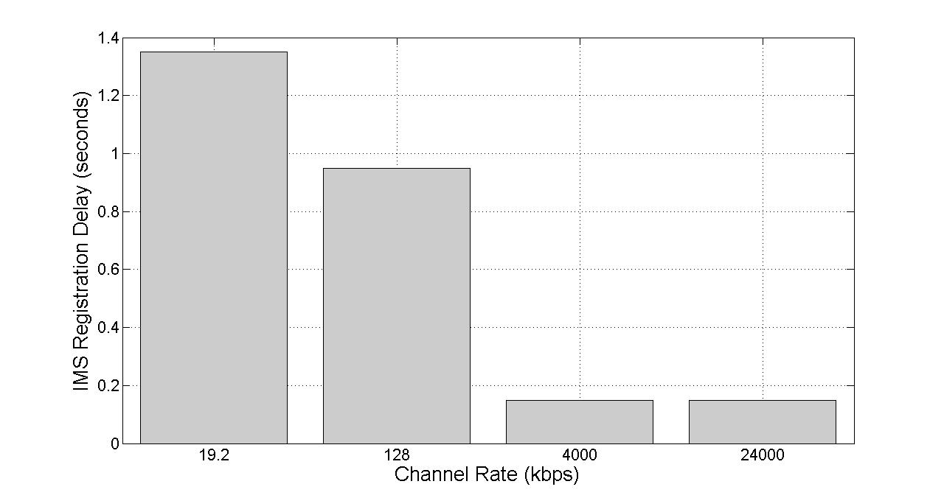
Results – IMS Registration Delay
Delay decreases with increased channel rate
WiMax delay is considerably less than 3G
3G
3G
WiMax
WiMax
IMS registration signaling delay for various channel rates for a fixed signaling arrival rate λ= 9 packets per second and frame error probability p = 0.02.

Slide 24
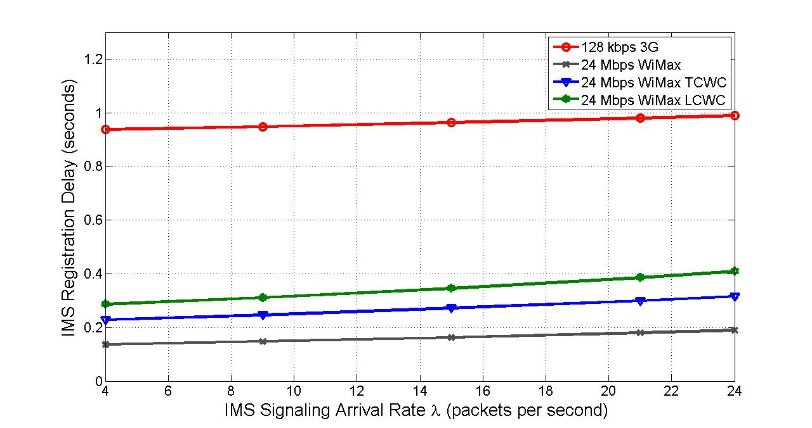
Results – Effects of Arrival Rate
Delay increases with increasing arrival rates
Delay in TCWC is lower than in LCWC
The effect of varying arrival rate λ on the IMS registration signaling delay for 128 kbps 3G and 24 Mbps WiMax networks with fixed frame error probability p = 0.02.

Slide 25
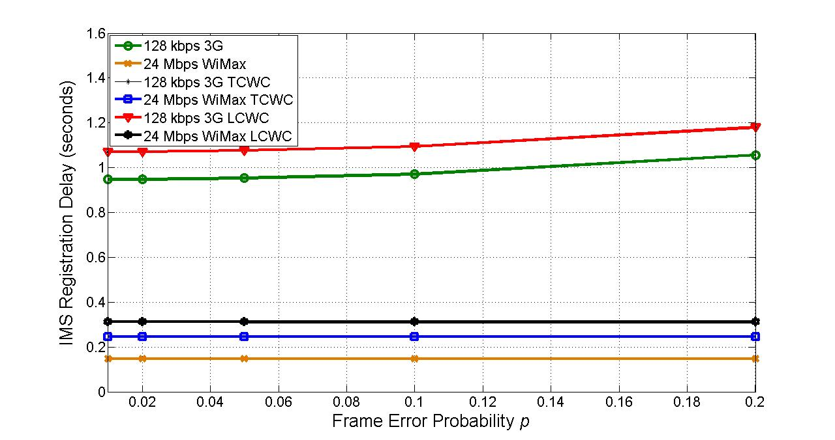
Results – Effects of Frame Error Probability
Delay is same for TCWC and LCWC for 3G
Delay in TCWC is lower than in LCWC for WiMax
Delay increases with increasing frame error probability
The effect of varying frame error probability p on the IMS registration signaling delay for 128 kbps 3G and 24 Mbps WiMax networks with fixed signaling arrival rate λ = 9 packets per second

Slide 26
Conclusions
Analyzed SIP-based IMS registration delay
  For 3G networks
  For WiMax networks
  The IMS signaling delay in WiMax is much less than 3G
  Encouraging results for WiMax deployment
  Positive results for WiMax-3G interworking
Tightly coupled architectures have lower IMS signaling delays than the loosely coupled architectures
  Tightly coupled systems provide more restriction on IMS delay
  However, tightly coupled architecture deployment requires more effort than loosely coupled architecture
  Tradeoff exists between performance efficiency and implementation cost

Slide 27

Questions?

