Slide 1
Exascale May Not Be Possible Without FPGAs
Ann Gordon-Ross and Greg Stitt
Assoc. Professors of ECE
University of Florida

Slide 2
Introduction
Goal: Enable exascale computing
Problem: petascale systems require > 10 MW of power
  Power and cooling costs exceed $1 million per month
  Clearly can’t just make petascale system 1000x bigger
Heavy focus on GPUs and specialized accelerators (e.g., KNL)
  Excellent performance, but high power (200+ W)
  Energy better than multi-core Xeon, but not enough for exascale
  Hard to cool 200 W devices in a supercomputer and/or datacenter
FPGAs widely shown to have significant energy advantages
  Reconfigurable hardware enables custom digital circuits
  without creating ASICs
  Enables circuits to act as a new form of software
Exascale may not be possible without FPGAs
  But many reasons why FPGAs are not yet a mainstream computing technology

Slide 3
Motivating Example: Intel Xeon+FPGA
Xeon+FPGA
  Arria 10 FPGA and Xeon Broadwell on same package
  FPGA shares memory with Xeon
2D convolution study
  Broadwell comparison
    96x less energy
    81x faster
  P6000 comparison
    15.7x less energy
    12.6x faster
Not representative of all applications
  Shows potential benefits
Energy Comparison of BDW+A10 vs. Broadwell
Energy Comparison of BDW+A10 vs. P6000 GPU

Slide 4
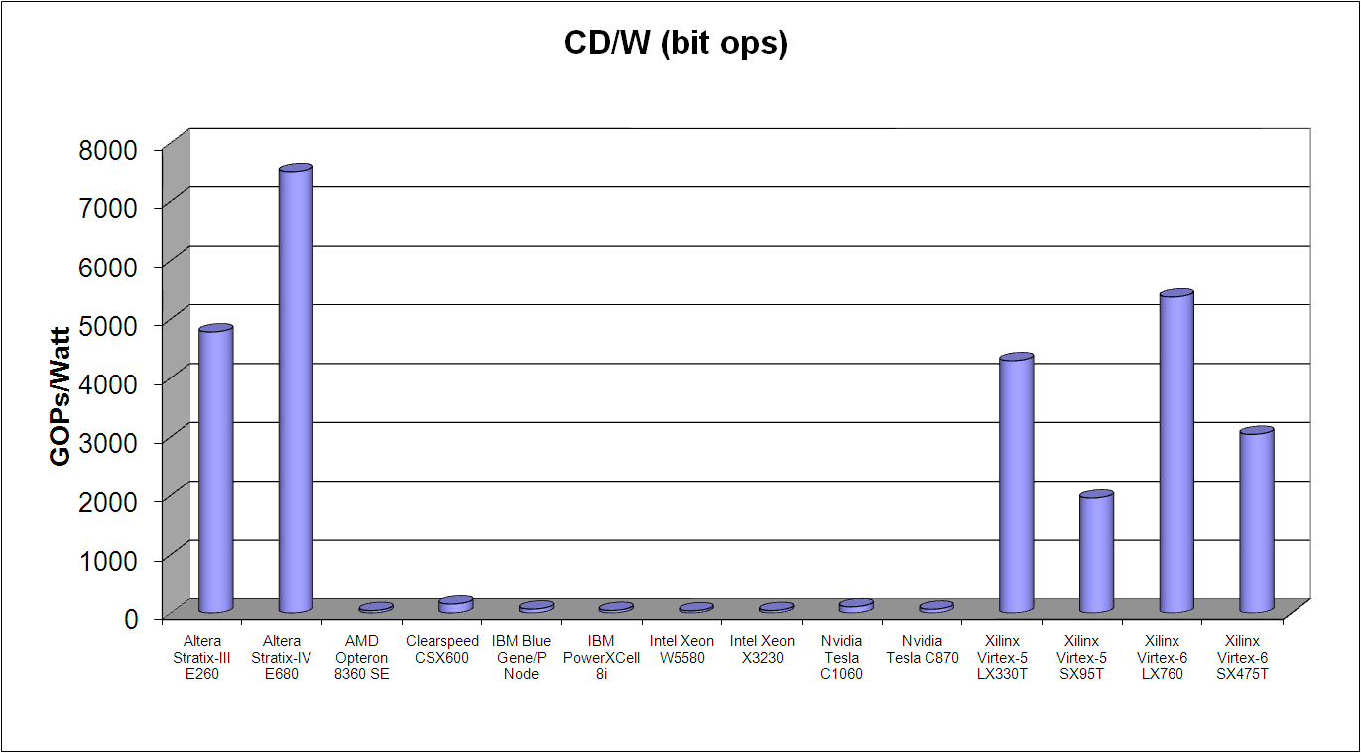


CD/W Results (selected HPC-related devices)
CD/W: Computational Density per Watt
Bit Operations

Slide 5
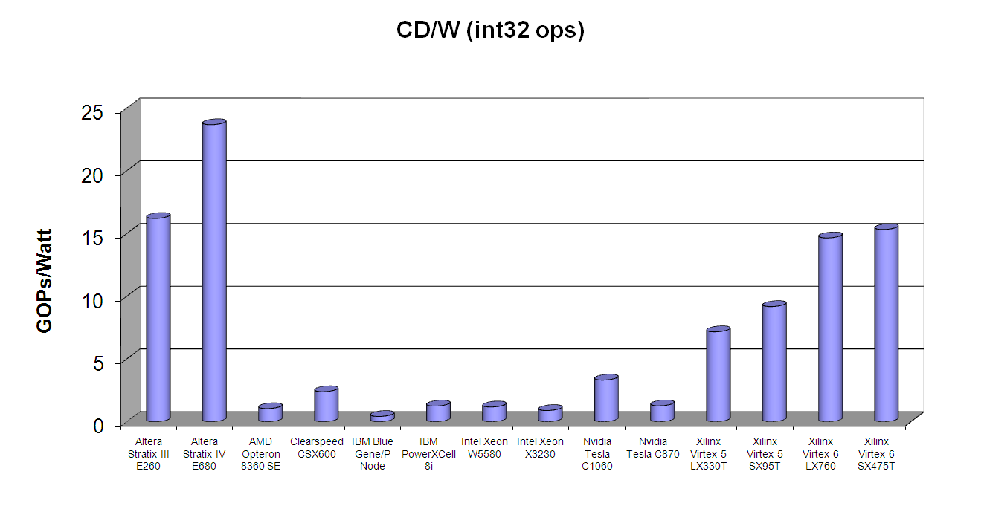


CD/W Results (selected HPC-related devices)
CD/W: Computational Density per Watt
32-bit Integer
Operations

Slide 6
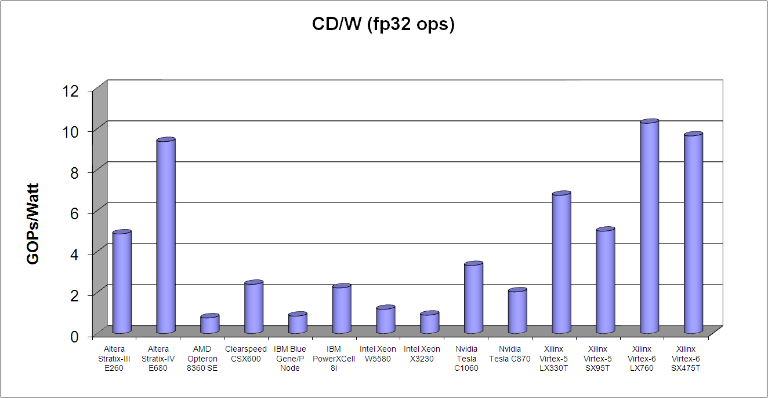


CD/W Results (selected HPC-related devices)
CD/W: Computational Density per Watt
Float Operations

Slide 7
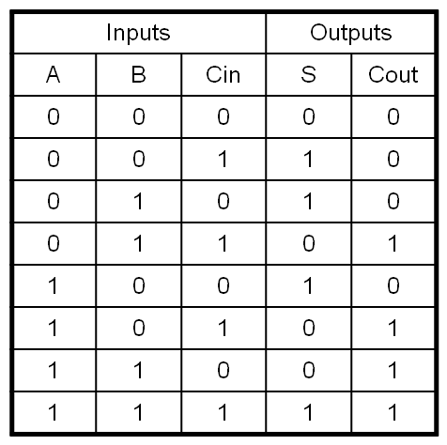
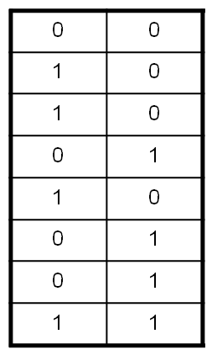
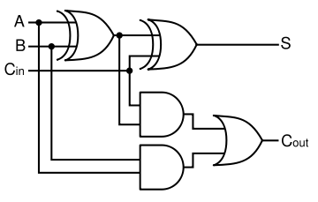
What are FPGAs?
Fundamental resource is look-up table (LUT)
  Enables specification of any combinational logic with same number of inputs and outputs
Truth Table
3-input, 2-output LUT
A
B
Cin
S
Cout

Slide 8
What are FPGAs?
LUTs typically combined into larger configurable logic blocks (CLBs)
  Enables sequential logic
2x1
3-in, 2-out
LUT
3-in, 2-out
LUT
CLB
FF
FF
FF
FF
2x1
2x1
2x1
2x1

Slide 9
What are FPGAs?
CLBs embedded in reconfigurable interconnect
  Routing tracks, switch boxes, connection boxes
  Enable arbitrary routing between CLBs
CLB
CLB
CLB
CLB
Connection box: Connects CLBs to tracks
CLB
CLB
CLB
CLB
Switch box: Connects different tracks
CLB
CLB
CLB
CLB

Slide 10
What are FPGAs?
FPGAs also commonly include:
  Small on-chip block RAM (BR)
  DSP units (multipliers, adders, etc.)
BR
CLB
DSP
DSP
CLB
BR
BR
CLB
DSP
DSP
CLB
BR
. . .
BR
CLB
DSP
DSP
CLB
BR
BR
CLB
DSP
DSP
CLB
BR
. . . .

Slide 11
Microsoft’s Project Catapult
Technology behind Microsoft’s hyperscale acceleration fabric
Nearly every new Microsoft data center combines an FPGA with a unique distributed architecture
Main driving force behind Bing search algorithms based on deep neural networks

Slide 12
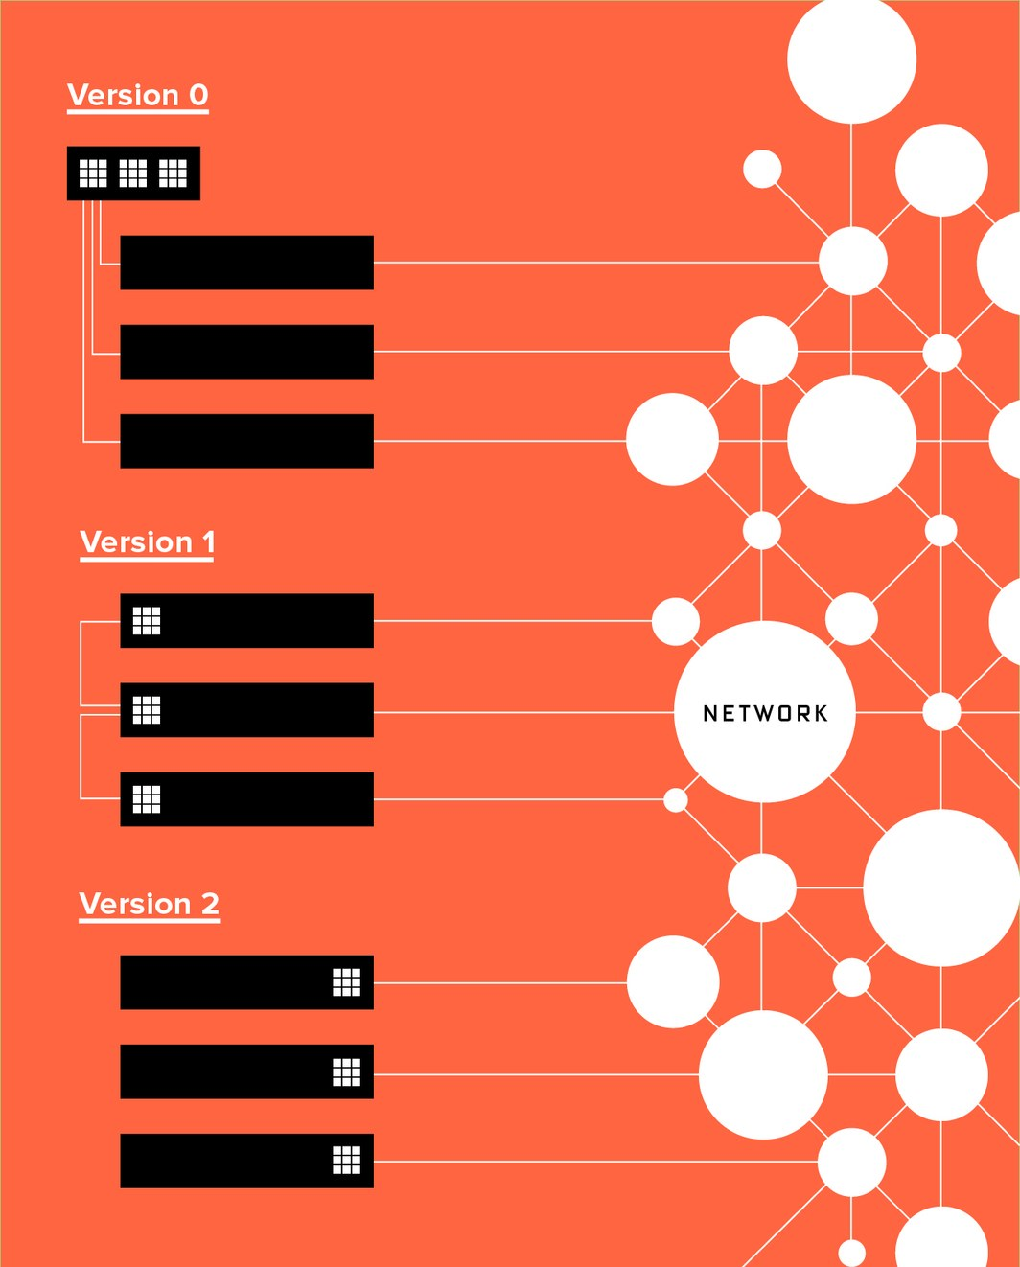
FPGA Placement Evolution
Version 0 – FPGAs in Torus network attached to each CPU
Version 1 – Single FPGA tightly coupled with each CPU
Version 2 – Single FPGA placed between network and CPU
“Microsoft Bets its Future on a Reprogrammable Computer Chip,”
Cade Metz, Wired, 2016

Slide 13
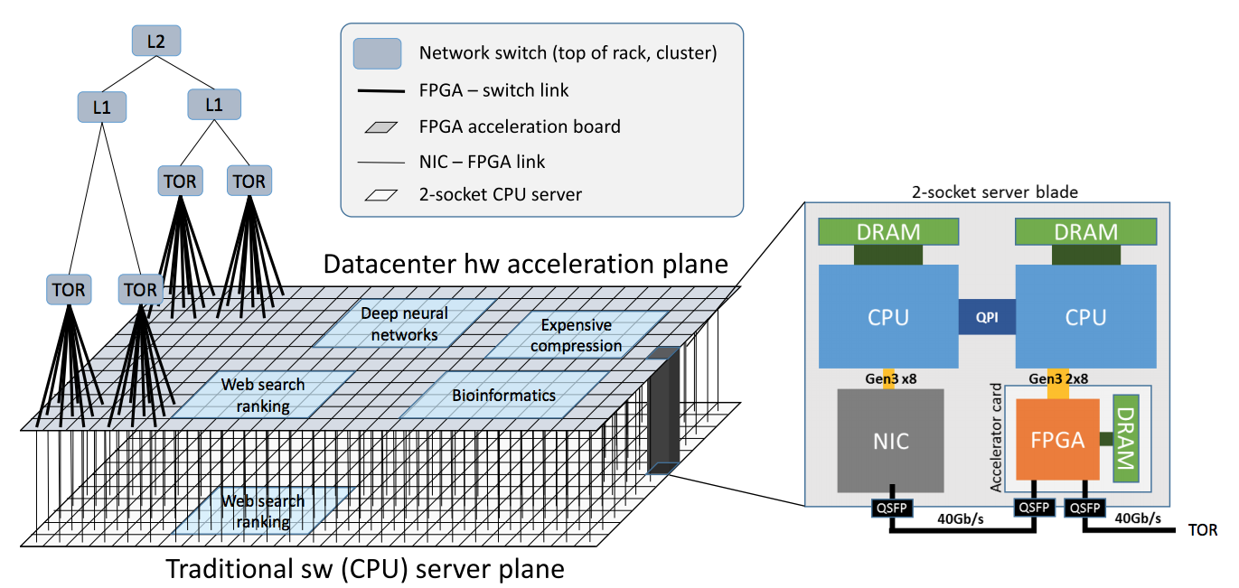
Catapult Version 2
“A Cloud-Scale Acceleration Architecture,” Caufield et al., 9th Annual IEEE/ACM
International Symposium on Microarchitecture, 2016.

Slide 14
Project Brainwave Results
Experimental setup
  14 nm Stratix 10
  GRU model 5X larger than Resnet-10
  Microsoft’s custom 8-bit floating point format
  No batching
Results
  39.5 Teraflops sustained
  Each request running in under 1 ms
  130,000 compute operations per cycle, one macro-instruction issued each 10 cycles
“Accelerating Persistent Neural Networks at Datacenter Scale,” Chung, E.,
Fowers, J., Ovtcharov, K., et al., Hot Chips, 2017.

Slide 15
Brainwave Power Consumption
Experimental setup
  Measures limitations of entire FPGA card (e.g., DRAM,
  I/O channels, and PCIe)
  Used power virus that exercises nearly all FPGA interfaces, logic, and DSP blocks
  Thermal chamber at worse case conditions (e.g., peak ambient temperature, high CPU load, and min air flow due to failed fan)
Results
  29.2 W
  Well within 32W TDP limitations for a single server
However, Catapult only available for Microsoft’s computing needs – public can’t buy/rent services
“Accelerating Persistent Neural Networks at Datacenter Scale,” Chung, E.,
Fowers, J., Ovtcharov, K., et al., Hot Chips, 2017.

Slide 16
Amazon Web Services (AWS)
FPGA-based compute network for public use
Buy/rent server time
Amazon EC2 F1
  Compute instance with FPGA
  Easy to program
  Complete environment with developing, simulation, debugging and compile hardware accelerators
    FPGA Developer AMI
    Hardware Developer Kit (HDK)

Slide 17
FPGA vs. GPU Performance
FPGA performance relies heavily on parallelism
  Clock speeds generally between 100-200 MHz
Pipelining (deep parallelism) main FPGA advantage over other devices
  Ideally one output per cycle
Replication (wide parallelism) generates multiple outputs per cycle
  Similar to GPU & multi-core parallelism
  GPUs have more pipes (cores), but much less throughput per pipe
    100s to 1000s of cores, throughput depends on application
  FPGAs have high-throughput pipelines, but generally fewer of them
    1 cycle per output per pipeline
General trends:
  FPGA wins when parallelism from pipelining+replication outweighs GPUs larger number of cores
FPGAs also have custom buffering capabilities that significantly improve throughput
*Not using AVX2

Slide 18
Why aren’t FPGAs more widely used?
5 main barriers preventing wider usage
  Increased application design complexity
    Significantly more complex that microprocessors or GPUs
  Limited applicability
    Not all applications benefit from FPGAs
  Prohibitive compilation times
    Placement and routing often takes hours, days, even more than a week
  Device cost
    Newest devices cost more than $10,000
  Lack of application/tool portability, standardization
    Application and tool designers must start over for new systems

