Slide 1



Enabling Right-Provisioned Microprocessor Architectures for the Internet of Things
Tosiron Adegbija¹, Anita Rogacs², Chandrakant Patel², and Ann Gordon-Ross³⁺
¹Department of Electrical and Computer Engineering
University of Arizona, Arizona, USA
²Hewlett-Packard (HP) Laboratories
Palo Alto, California, USA
³Department of Electrical and Computer Engineering
University of Florida, Florida, USA
+Also Affiliated with NSF Center for High-Performance Reconfigurable Computing
This work was supported in part by National Science Foundation (NSF) grant CNS-0953447

Slide 2
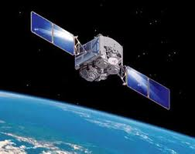

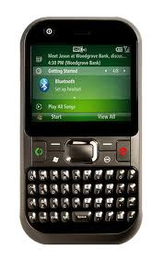






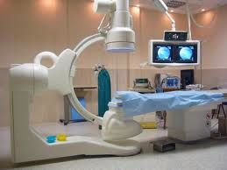
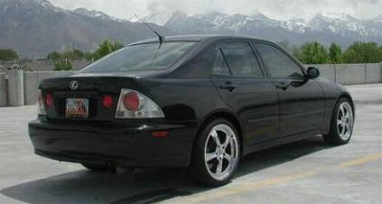



Introduction
Internet of Things (IoT): pervasive presence of uniquely identifiable, connected devices
Goal: Reduce reliance on human intervention for data acquisition, visualization and use

Slide 3
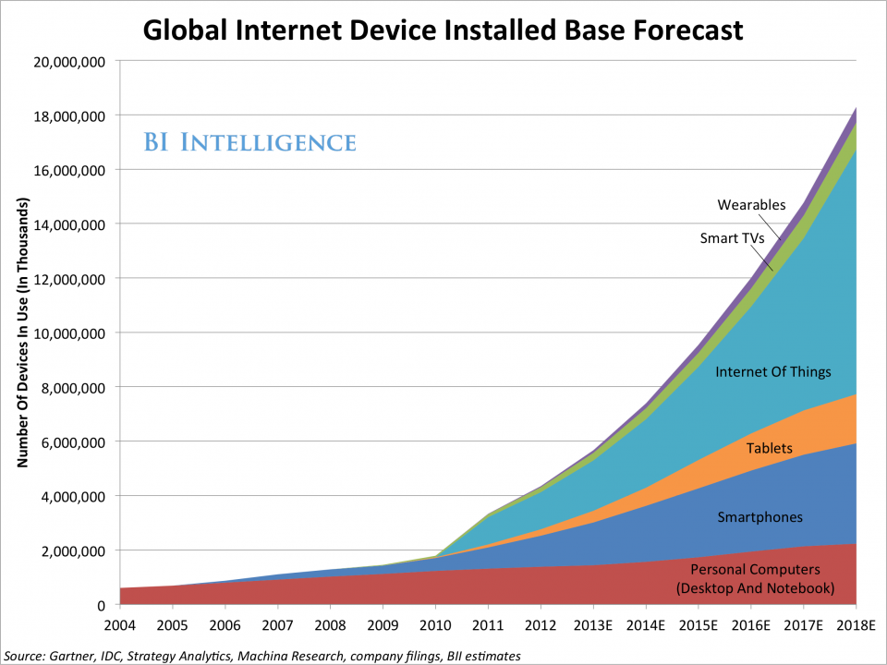
Motivation – IoT Impact
Wide-ranging use-cases
  Healthcare, manufacturing, smart cities, transportation
  Transformative to work, life, and the global economy
[Gartner Research, 2014]
26 billion devices by 2020
$3 trillion economic impact

Slide 4
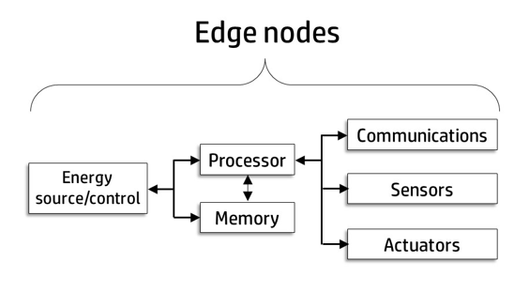
Traditional IoT Model and Challenges
Edge node
Edge node
Head node
Edge node
Edge node
Edge node
Transmission is expensive
Bandwidth bottleneck
Real-time constraints
Complex applications
Increased energy consumption and latency

Slide 5
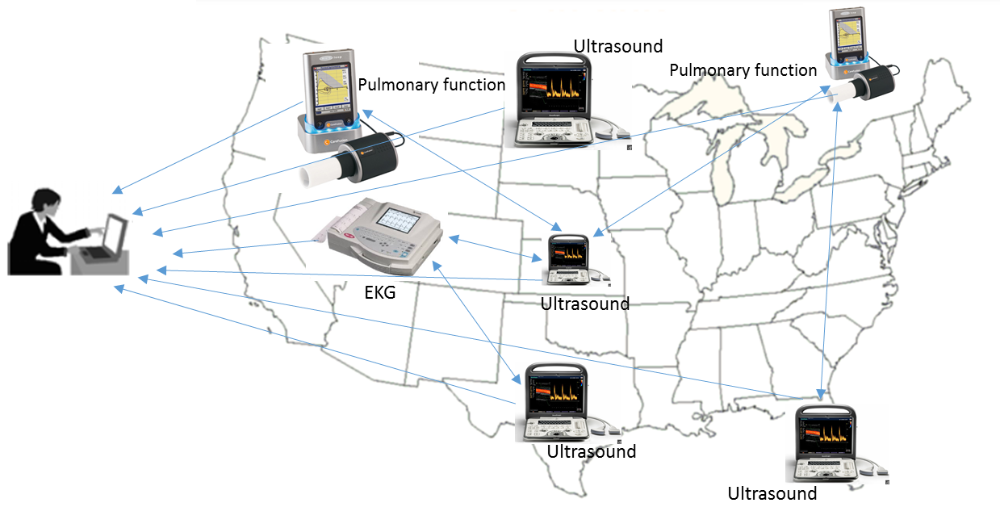
IoT Optimization
Edge Computing
  Move computations to the edge nodes
Example
  Medical diagnostics
Requirements
  Sufficient compute power
  Maintain low-energy
  Maintain form factor
What microprocessor architectures will support edge computing?

Slide 6
Contributions
Propose broad and tractable classification of IoT applications
  Identify key application functions
Evaluated state of the art microprocessor characteristics
  Focus on CPU component
Identify highest impact microarchitecture characteristics
  Enable efficient design space exploration
  Impact of leakage power optimization
Lay foundation for right-provisioning of IoT device microprocessors

Slide 7
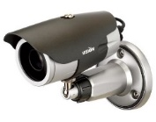
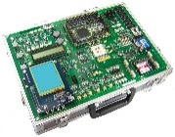
Determining a Right-Provisioned Architecture
IoT
use case
Image capture | Sensing | Memory intensity
 | Image processing | Compute/memory intensity, parallelism
Face detection | Image processing | Compute/memory intensity, parallelism
Face recognition | Image processing | Compute/memory intensity, parallelism
Data encryption | Security | Compute intensity
Data transmission | Compression | Compute intensity
 | Communication | Compute intensity
Applications
Application functions
Execution characteristics
Right-provisioned architecture

Slide 8
IoT Application Classification
Surveyed several IoT use-cases
Classified applications based on functions
Application function | Benchmark | Benchmark description
Sensing | matrixTrans (_128, _256, _512, _1024) | Dense matrix transpose of n × n matrix
Communications | fft (_small and _large) | Fast Fourier Transform
Image processing | matrixMult (_128, _256, _512) | Dense matrix multiplication of n × n matrix
Lossy compression | jpeg (_small and _large) | Joint Photographic Experts Group (JPEG) compression
Lossless compression | lz4 (_mr and _xray) | Lossless data compression
Security | sha (_small and _large) | Secure hash algorithm
Fault tolerance | crc (_small and _large) | Cyclic redundancy check

Slide 9
IoT Microarchitecture Configurations
Surveyed state of the art IoT microprocessors
  Ranging from microcontrollers to high-performance embedded systems microprocessors
  Goal: Identify technology gaps in state of the art
 | Conf1 | Conf2 | Conf3 | Conf4
Sample CPU | ARM Cortex M4 | Intel Quark | ARM Cortex A7 | ARM Cortex A15
Frequency | 48 MHz | 400 MHz | 1 GHz | 1.9 GHz
Number of cores | 1 | 1 | 4 | 4
Pipeline stages | 3 | 5 | 8 | 15
Cache | None | None | 32 KB i/d L1, 1MB L2 | 32 KB i/d L1, 2MB L2
Memory | 512 KB flash | 2 GB RAM | 2 GB support | 1 TB RAM support
Execution | In-order | In-order | In-order | Out-of-order

Slide 10
Experimental Methodology
Simulators
  GEM5 Simulator
  Did not simulate the impact of parallelism
  McPAT: power
  Perl scripts to drive simulations
Analysis
  Execution characteristics: memory and compute intensity
  Impact of different data sizes
  Benchmarks’ execution time, energy, performance and efficiency
  Sensitivity to clock frequency, inorder vs. out-of-order execution, cache sizes
  Impact of idle energy/power optimization

Slide 11
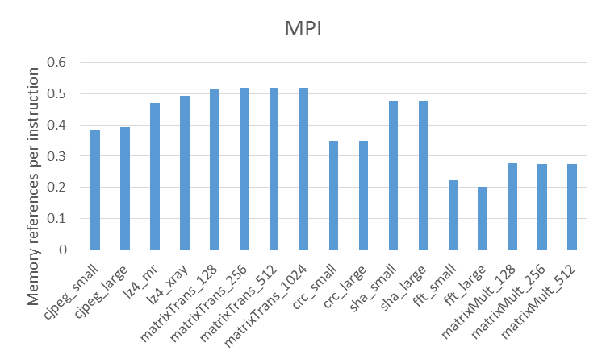
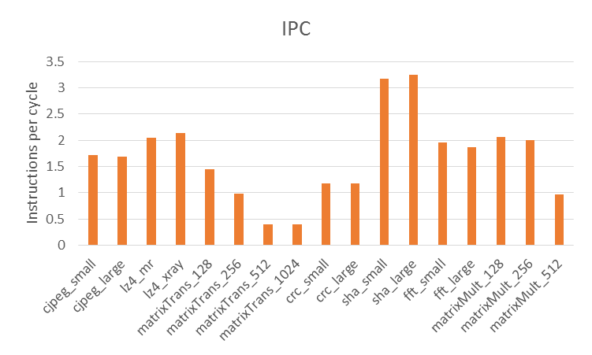
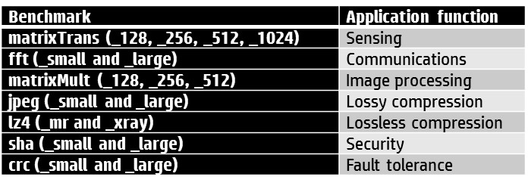
Execution characteristics
Memory references per instruction (MPI) and Instructions per Cycle (IPC)
Similar characteristics for different data sizes
  Exception: matrixTrans and matrixMult
MatrixTrans: IPC reduction from 128 to 512
MatrixMult: IPC reduction from 256 to 512
Notes:
Evaluated on conf4
MPI is microarchitecture-independent; IPC is microarchitecture-dependent
MatrixTrans is the most memory intensive (memory intensity has to do with memory references per instruction, and not data sizes)
FFT is compute intensive but not memory intensive (relative to the other benchmarks)
SHA is both memory intensive and compute intensive

Slide 12
Comparison of the Configurations
Energy and execution time normalized to conf4 for a single execution
Conf1 could not execute some applications due to insufficient memory
Conf4 outperforms all configurations for a single execution
  Energy does not take into account idle energy
  For specific latency requirements, only benchmark on one configuration and extrapolate to others
Notes:
Mention that this does not include the effect of leakage power.
Execution time: Conf1, conf2, and conf3 increase 202x, 23x, and 9x.
Run on conf4, estimate performance on smaller configurations
Energy: conf1, conf2, and conf3 increase 35x, 4.6x, and 4.7x

Slide 13
Comparison of the Configurations
Performance (GOPS) and efficiency (GOPS/W) normalized to conf4
Conf1, conf2, and conf3 had 171x, 17x, and 8x worse performance than conf4, respectively
Conf1, conf2, and conf3 had 33x, 4x, and 4x worse efficiency than conf4, respectively
What are the highest-impact microarchitectural characteristics?
Notes:
Similar results to previous slides.

Slide 14
Impact of Clock Frequency
1 GHz clock frequency normalized to 1.9 GHz (evaluated on conf4)
1 GHz increased execution time and energy by 62% and 32% on average
  No execution time change for matrixTrans
1 GHz reduced energy by 4% for matrixTrans
1 GHz reduced performance and efficiency by 40% and 27% on average
  4% efficiency improvement for matrixTrans
Notes:
To see which microarchitectural characteristics have the highest impact
Mention that conf4 is the baseline

Slide 15
Impact of Execution Order
Inorder normalized to out-of-order (evaluated on conf4)
Inorder average 4.8x slower than OoO
  As high as 9x for sha
Inorder consumes average 2.9x more energy than OoO
Inorder 4.8x and 2.9x worse performance and efficiency, respectively
Notes:
Big picture: OoO is the better option, complexity depends on specific implementation
Execution order has the biggest impact on overall performance and energy consumption.
Bigger impact for more compute intensive and memory intensive benchmarks: can continue computations while waiting for memory

Slide 16
Impact of Cache Sizes
16 K data cache normalized to 32 K cache (evaluated on conf4)
Very little change in execution time (< 4%)
16K consumes about 4% less energy
16K degrades performance by 3% on average
16K improves efficiency by 5% on average

Slide 17
Impact of Cache Sizes
Data cache miss rates: 16 K cache normalized to 32 K
16K results in average 18% more cache miss rates than 32K
  As high as 82% for lz4
No change for matrixTrans, crc, and matrixMult

Slide 18
Impact of Idle Energy on Overall Energy Consumption
Execution of a single benchmark
Sensor readings every 40s
Energy consumed in 1 hour
  90 readings
76%
27%
34%
Conf1 consumes least energy overall
Conf3 and conf4 have high leakage power
76%
CRC every 10 mins
Energy consumed in 1 hour
  6 computations
32%
35%
Can the idle energy be optimized?
Notes:
Complete opposite of single executions
Without optimization, conf1 is the best option
What happens when we optimize the energy across all the configurations?

Slide 19
Impact of Idle Energy on Overall Energy Consumption
Impact of power gating: 95% leakage power reduction
Sensor readings every 40s
Energy consumed in 1 hour
  90 readings
Conf1 provides the most benefit
Impact of power gating depends on
application run time
CRC every 10 mins
Energy consumed in 1 hour
  6 computations
Conf2 provides the most benefit

Slide 20
Impact of Idle Energy on Overall Energy Consumption
Execution of multiple benchmarks
Six applications in succession every 10 mins
Energy consumed in 1 hour
  6 computations
Conf2 provides the most benefit without power gating
Conf4 provides the most benefit with power gating
Longer executions on larger configurations provide greater optimization benefit
Notes:
Conf1 could not run these benchmarks (selected randomly)

Slide 21
Conclusions
Explored architectural support for the Internet of Things (IoT)
  Foundation for further research
  Proposed IoT application functions and benchmarks
  Quantified impact of execution order, frequency, and cache sizes
  Showed that power optimization depends on configuration and application runtime
Enabling right-provisioning for IoT devices
  Our work helps to reduce design space exploration
  Given application requirements, estimate configurations
Notes:
Given application requirements, our work provides a framework for analyzing IoT devices and selecting the best configurations for edge computing on the IoT.

Slide 22
Questions and Comments

