Slide 1
Parallelized Benchmark-Driven Performance Evaluation of SMPs and Tiled Multi-Core Architectures for Embedded Systems
Arslan Munir*, Ann Gordon-Ross⁺ , and Sanjay Ranka#
Department of Electrical and Computer Engineering
#Department of Computer and Information Science and Engineering
*Rice University, Houston, Texas
^{+#}University of Florida, Gainesville, Florida, USA
⁺ Also affiliated with NSF Center for High-Performance Reconfigurable Computing
This work was supported by the Natural Sciences and Engineering Research Council of Canada (NSERC) and the National Science Foundation (NSF) (CNS-0953447 and CNS-0905308)

Slide 2
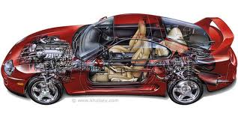
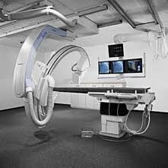
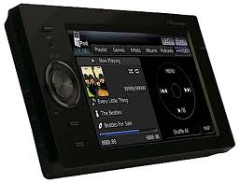
Introduction and Motivation
Systems within or
embedded into
other systems
Embedded
Systems
Automotive
Applications
Space
Medical
Consumer
Electronics

Slide 3
Introduction and Motivation
Multi-core embedded systems
Moore’s law supplying billion of transistors on-chip
Increased computing demands from embedded system with constrained energy/power
A 3G mobile handset’s signal processing requires 35-40 GOPS
Constraints: power dissipation budget of 1W
Performance efficiency required: 25 mW/GOP or 25 pJ/operation
Multi-core embedded systems provide a promising solution
to meet these performance and power constraints
Multi-core embedded systems architecture
Processor cores
Caches: level one instruction (L1-I), level one data (L1-D),
last-level caches (LLCs) level two (L2) or level three (L3)
Memory controllers
Interconnection network
Challenge: Evaluation of
diverse multi-core architectures
Many architectures support
different parallel programming
languages
Motivation: Proliferation of diverse
multi-core architectures

Slide 4
Introduction and Motivation
Benchmark runs on
a physical multi-core
platform
Benchmark runs on a multi-core simulator
Multi-core Architecture
Evaluation Approaches
Focus of our work
Benchmark-driven
simulative approach
Benchmark-driven
experimental approach
Analytical modeling
approach
Models the multi- core architectures
+ Most accurate
+ Faster than simulative
‒ Cannot be used for design tradeoff evaluation
‒ Requires representative and diverse benchmarks
+ Good method for design evaluation
‒ Requires an accurate multi-core simulator
‒ Requires representative and diverse benchmarks
‒ Lengthy simulation time
+ Fastest
+ Benchmarks are not required
‒ Accurate model development is challenging
‒ Trades off accuracy for faster evaluation

Slide 5
Contributions
Evaluates symmetric multiprocessors (SMPs)
and tiled multi-core architectures (TMAs)
First work to
cross-evaluate
SMPs and TMAs
Parallelized benchmarks
Information fusion application
Gaussian elimination (GE)
Embarrassingly parallel (EP)
Benchmarks parallelization
for SMPs using OpenMP
Performance metrics
Execution time
Speedup
Efficiency
Cost
Performance
Performance per watt
Benchmarks parallelization
for TMAs (TILEPro64)
using Tilera’s ilib API

Slide 6
Related Work
Parallelization and performance analysis
Sun et al. [IEEE TPDS, 1995] investigated performance metrics (e.g., speedup, efficiency, scalability) for shared memory systems
Brown et al. [Springer LNCS, 2008] studied performance and programmability comparison for Born calculation using OpenMP and MPI
Zhu et al. [IWOMP, 2005] studied performance of OpenMP on IBM Cyclops-64 architecture
Our work differs from the previous parallelization and performance analysis work
Compares performance of different benchmarks using OpenMP and Tilera’s ilib API
Compares two different multi-core architectures
Multi-core architectures for parallel and distributed embedded systems
Dogan et al. [PATMOS, 2011] evaluated single- and multi-core architectures for biomedical signal processing in wireless body sensor networks (WBSNs)
Kwok et al. [ICPPW, 2006] proposed FPGA-based multi-core computing for batch processing of image data in distributed embedded wireless sensor networks (EWSNs)
Our work differs from the previous work
Parallelize information fusion application and GE for two multi-core architectures

Slide 7
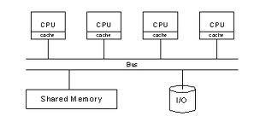
Symmetric Multiprocessors (SMPs)
SMPs ➔ most pervasive and prevalent type of multi-core architecture
SMP architecture
Symmetric access to all of main memory
from any processor core
Each processor has a private cache
Processors and memory modules attach
to a shared interconnect ➔ typically a shared bus
SMP ➔ in this work
Intel-based SMP
8-core SMP
2x Intel’s Xeon E5430 quad-core processor (SMP^{2xQuadXeon})
45 nm CMOS lithography
Maximum clock frequency ➔ 2.66 GHz
32 KB L1-I and 32 KB L1-D cache per Xeon E5430 chip
12 MB unified L2 cache per Xeon E5430 chip

Slide 8
Tiled Multi-core Architectures (TMAs)
Interconnection Network
Connects tiles on the chip
Tile
A processor core with a switch
TMA Examples
TILEPro64
Raw processor
Intel’s Tera-Scale
research processor
Tilera’s TILE64
Tilera’s TILEPro64
8x8 grid of 64 tiles
Each tile
3-way VLIW pipe-lined
max clock frequency
866 MHz
Private L1 and L2 cache
Dynamic Distributed Cache (DDC)
Tilera’s TILEPro64
Many-core Chip

Slide 9
Benchmarks
Information Fusion
A crucial processing task in distributed embedded systems
Condenses the sensed data from different sources
Transmits selected fused information to a base station node
Important ➔ applications with limited transmission bandwidth (e.g., EWSNs)
Considered Application
Cluster ➔ 10 sensor nodes
Attached sensors: Temperature, pressure, humidity, acoustic, magnetometer,
accelerometer, gyroscope, proximity, orientation
Cluster head
Implements moving average filter ➔ reduces noise from measurements
Calculates minimum, maximum, and average of sensed data
O(NM) operations
N ➔ number of samples to be fused
M ➔ moving average window size

Slide 10
Benchmarks
Gaussian Elimination
Solves a system of linear equations
Used in many scientific applications
LINPACK benchmark ➔ ranks supercomputers
Decoding algorithm for network coding ➔ Variant of GE
O(n³) operations
n ➔ number of linear equations to be solved
Embarrassingly Parallel
Quantifies the peak attainable performance of a parallel architecture
Generation of normally distributed random variates
Box-Muller’s algorithm
99n floating point (FP) operations
n ➔ number of random variates to be generated

Slide 11
Parallel Computing Device Metrics
Measures the performance
gain achieved by parallelization
S = T_{s}/T_{p}
Parallel Computing
Device Metrics
Helps in comparing
different architectures
Run Time
Speedup
Efficiency
Cost
Scalability
Measures the fraction
of time for which the
processor is usefully
employed
E = S/p
Measures the sum
of time that each
processor spends
solving the problem
C = T_{p} . p
Serial run time T_{s}
Time elapsed between
the beginning and the
end of the program
Parallel run time T_{p}
Time elapsed from the
the beginning of a
program to the moment
last processor finishes
execution
Measures the system capacity
to increase speedup in proportion
to the number of processors

Slide 12
Results – Information Fusion Application
Performance results for the information fusion application for SMP^{2xQuadXeon} when M = 40
The multi-core processor speeds up the execution time as compared to a single-core processor
The multi-core processor ⬆ the throughput (MOPS) as compared to a single-core processor
The multi-core processor ⬆ the power-efficiency as compared to a single-core processor
Four processor cores (p = 4) attain 49% better performance per watt than a single-core
M is moving average filter’s window size
N denotes the number
of samples to be fused
Results are obtained with compiler optimization level -O3

Slide 13
Results – Information Fusion Application
Performance results for the information fusion application for TILEPro64 when M = 40
The multi-core processor speeds up the execution time
Speedup is proportional to the number of tiles p (i.e., ideal speedup)
The efficiency remains close to 1 and cost remains constant indicating ideal scalability
The multi-core processor ⬆ the throughput and power-efficiency as compared to a single-core processor
Increases MOPS by 48.4x and MOPS/W by 11.3x for p = 50
Results are obtained with compiler optimization level -O3

Slide 14
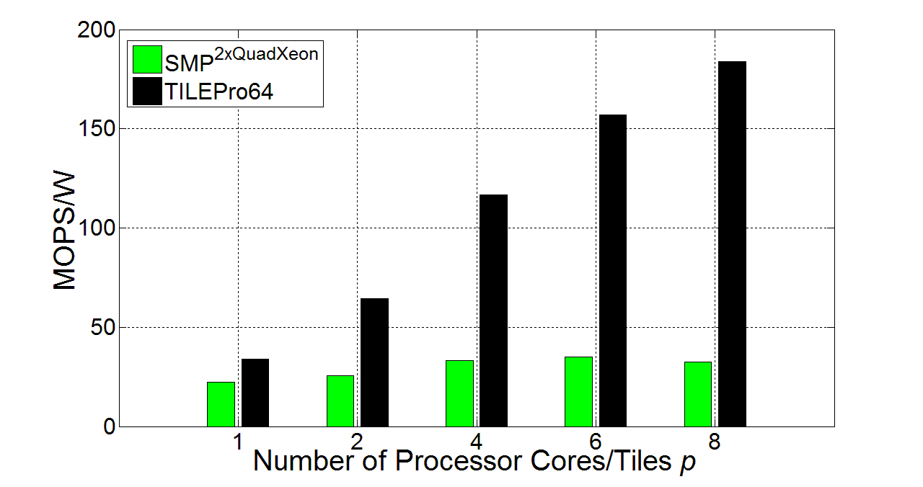
Results – Information Fusion Application
Operation on private data of various sensors/sources ➔ very well parallelizable using Tilera’s ilib API
TILEPro64 exploits data locality
TILEPro64 delivers higher performance per watt as compared to SMP^{2xQuadXeon}
TILEPro64 attains 466% better performance per watt than the SMP for
p = 8
OpenMP sections and parallel construct requires sensed data to be shared by operating threads
Performance per watt (MOPS/W) comparison between SMP^{2xQuadXeon} and TILEPro64 for the information fusion application when N = 3000,000

Slide 15
Results – Gaussian Elimination
Performance results for the Gaussian elimination benchmark for SMP^{2xQuadXeon}
The multi-core processor speeds up the execution time as compared to a single-core processor
Speedup is proportional to the number of tiles p (i.e., ideal speedup)
The efficiency remains close to 1 and cost remains constant indicating ideal scalability
The multi-core processor ⬆ the throughput and power-efficiency as compared to a single-core processor
Increases MOPS by 7.4x and MOPS/W by 2.2x for p = 8
m is the number of linear equations and
n is the number of variables in a linear equation
Results are obtained with compiler optimization level -O3

Slide 16
Results – Gaussian Elimination
Performance results for the Gaussian elimination benchmark for TILEPro64
The multi-core processor speeds up the execution time
Speedup is much less than the number of tiles p
The efficiency ⬇ and cost ⬆ as p ⬆ indicating poor scalability
The multi-core processor ⬆ the throughput and power-efficiency as compared to a single-core processor
Increases MOPS by 14x and MOPS/W by 3x for p = 56
Results are obtained with compiler optimization level -O3

Slide 17
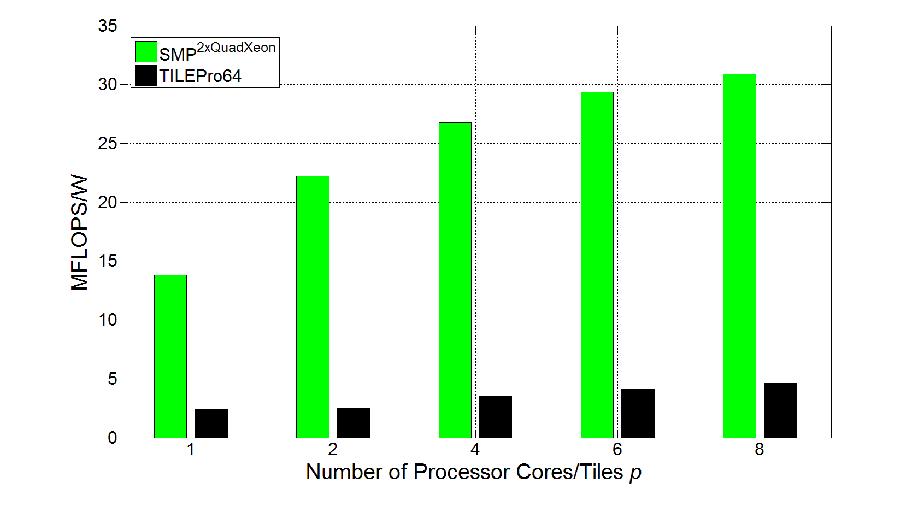
Results – Gaussian Elimination
Lots of communication and synchronization operations ➔ favors SMPs as communication transforms to read & write in shared memory
SMP^{2xQuadXeon} delivers higher MFLOPS/W than TILEPro64
SMP^{2xQuadXeon} attains 563% better performance per watt than TILEPro64 for p = 8
Higher external memory bandwidth of the SMP helps attaining better performance than TILEPro64
Performance per watt (MFLOPS/W) comparison between SMP^{2xQuadXeon} and TILEPro64 for the GE benchmark when (m, n) = (2000, 2000)

Slide 18
Insights Obtained from Parallelized Benchmark-Driven Evaluation
Compiler optimization flag – O3 ➔ optimizes performance both for SMPs and TMAs
The multi-core processor ⬆ speeds up, throughput, and power-efficiency as compared to a single-core processor both for SMPs and TMAs
State-of-the-art SMPs outperform TMAs in terms of execution time
For EP benchmark: Intel-based SMP ➔ 4x better performance per watt when p = 8
TMAs can provide comparable performance per watt as that of SMPs
TMAs outperforms SMPs for applications
More private data
Little dependency
Data locality
For information fusion application: TILEPro64 efficiency ➔ close to 1 and
cost ➔ constant ➔ ideal scalability
TILEPro64 ➔ 466% better performance per watt than an Intel-based SMP when p = 8
SMPs outperforms TMAs for applications
Excessive synchronization
Excessive dependency
Shared data
For GE benchmark: Intel-based SMP ➔ 563% better perf./watt than TILEPro64 when p = 8

Slide 19
Questions?

