Slide 1
Analysis of Cache Tuner Architectural Layouts for Multicore Embedded Systems
Tosiron Adegbija¹, Ann Gordon-Ross¹⁺,and Marisha Rawlins²
¹Department of Electrical and Computer Engineering
University of Florida, Gainesville, Florida, USA ²Center for Information and Communication Technology University of Trinidad and Tobago, Trinidad and Tobago
⁺ Also Affiliated with NSF Center for High-Performance Reconfigurable Computing
This work was supported by National Science Foundation (NSF) grant CNS-0953447

Slide 2
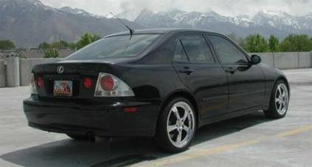
Introduction and Motivation
Embedded systems are ubiquitous and have stringent design constraints
Increasing demand for high performance embedded systems
Shift to multicore embedded systems
Increases system and optimization complexity
Need optimizations that reduce power without increasing overheads
Overheads: performance, area, etc.

Slide 3
Optimization – Cache Tuning
Caches are a good candidate for optimization
Significant impact on power and performance
Different applications have different cache parameter value requirements
Parameter values: cache size, line size, associativity
Cache tuning determines appropriate/optimal parameter values (cache configurations) to meet optimization goals (e.g., lowest energy)
Download application
Cache tuning requires
- tunable/configurable cache
- tuning hardware (cache tuner)
- tuning hardware (cache tuner)
Tunable cache
Cache tuner
Microprocessor

Slide 4
Configurable Cache Architecture
Configurable caches enable cache tuning
Design space: combination of all possible configurations
A Highly Configurable Cache (Zhang ‘03)
Way concatenation
Way shutdown
2KB
2KB
2KB
2KB
Configurable Line size
2KB
2KB
2KB
2KB
2KB
2KB
2KB
2KB
8 KB, 2-way
4 KB, 2-way
8 KB, 4-way base cache
2KB
2KB
2KB
2KB
16 byte physical line size
2KB
2KB
2KB
2KB
8 KB, direct-mapped
2 KB, direct-mapped
Tunable Associativity
Tunable Size
Tunable Line Size

Slide 5
Cache Tuners
Tuner evaluates different configurations to determine the best configuration
Implements tuning algorithm/heuristic to search design space
Best configuration satisfies design objective (e.g., minimum energy/execution time)
Can impose overheads (tuning delay, power, area) and complexity
Software cache tuners
Intrusive to application and cache
Non-optimal, inferior configurations
Hardware cache tuners
Non-intrusive to application
Must be low-overhead
Previous work
Single- and dual-core cache tuners
More cores = more tuner overhead/complexity
Number of cores
Tuner overhead/complexity
Tuner overhead and
complexity
Number of cores
Need low-overhead cache tuners for multicore systems!
Notes:
Cache tuners can impose additional overheads
Tuning delay: cycles elapsed during tuning – may stall the processor
Options for cache tuners
Software: intrusive, affects application and cache behavior due to context switching
Can select non-optimal configurations
Hardware: non-intrusive, must be low overhead
Previous work: single and dual-core cache tuners
Additional cores increase design complexity

Slide 6
Cache Tuner Architectural Layouts
Overheads incurred
Global tuner
Single tuner for all cores
Shared resource bottleneck
Tuning delay
Little area/power
Tuning delay
Area overhead
Power overhead
Core 1
L1 Cache
Core 2
L1 Cache
Core 3
L1 Cache
Core 4
L1 Cache
Tuner
Global tuner

Slide 7
Cache Tuner Architectural Layouts
Dedicated tuners
Separate tuner for each core
Resources not shared
Less tuning delay
More area/power
Overheads incurred
Tuning delay
Area overhead
Power overhead
Core 1
L1 Cache
Core 2
L1 Cache
Core 3
L1 Cache
Core 4
L1 Cache
Tuner 1
Tuner 2
Tuner 3
Tuner 4
Dedicated tuners

Slide 8
Cache Tuner Architectural Layouts
Clustered tuners
Separate tuner for core subset
Shared resources
Tuning delay
Tradeoff area/power and tuning delay
Overheads incurred
Tuning delay
Area overhead
Power overhead
Core 1
L1 Cache
Core 2
L1 Cache
Core 3
L1 Cache
Core 4
L1 Cache
Tuner 1
Tuner 2
Clustered tuners
Cluster size must be carefully selected!

Slide 9
Contributions
Challenges
Low-overhead tuners required for > dual core systems
Cluster sizes must be carefully selected
Tradeoff power, area, and shared resource contention
Our work
Design custom cache tuners for multicore embedded systems
Scalable
Low-overhead
Quantify tradeoffs of cache tuner architectural layouts
Formulate essential design guidelines for cache tuners

Slide 10
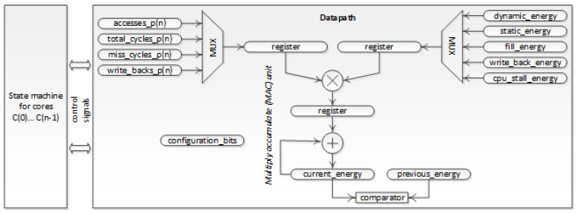
Hardware Implementation
Implemented cache tuners in multiple architectural layouts
2-, 4-, 8-, and 16-core systems
Cache tuner
State machine
Datapath
Core1
Core2
Global tuner
Core3
Core1
Core4
Core2
Clustered tuners
Core3
Core1
Core4
Core2
Dedicated tuners
Core3
Core4

Slide 11
State Machine
Parameter state
changes the parameter being tuned
S0
start = 1
S1
S3
S4
start = 0
adjust_parameter
= none
adjust_parameter
= size
adjust_parameter
= line_size
adjust_parameter
= associativity
tune_again = 0
start = 1
Value state
changes the value of the parameter being tuned
configuration bits
V0
tune_again = 1
adjust_parameter
size (KB)
line_size (byte)
associativity
V1
V2
V3
V4
V5
2
16
1-way
4
32
2-way
8
64
4-way
16
---
---
32
---
---
control signal
calc_done = 1
calc_start = 1
Calculation state
calculates energy consumption
C5
C4
busy bit
C0
C3
control
signals
C1 – Dynamic energy
C2 – Static energy
C3 – Write back energy
C4 – Cache fill energy
C5 – CPU stall energy
Datapath
C1
C2
1, next parameter value
{
tune_again =
0, next parameter

Slide 12
Datapath
State machine
for cores
C(0)… C(n-1)
Datapath
dynamic_energy
accesses_p(n)
total_cycles_p(n)
static_energy
MUX
register
register
MUX
fill_energy
miss_cycles_p(n)
write_back_energy
write_backs_p(n)
X
cpu_stall_energy
control
signals
register
configuration bits
Multiply accumulate (MAC) unit
+
current_energy
previous_energy
comparator

Slide 13
Experimental Setup
Cache tuners evaluated
Global and dedicated tuners: 2-, 4-, 8-, and 16-cores
Clustered tuners:
4-, 8-, and 16-cores: 2-core clusters
8- and 16-cores: 4-core clusters
16-cores: 8-core clusters
Modeled with synthesizable VHDL in Synopsys Design Compiler
11 benchmarks from Splash-2 benchmark suite
SESC simulator provided cache statistics

Slide 14
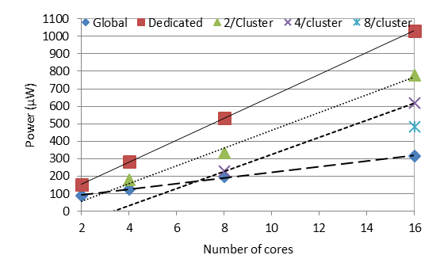
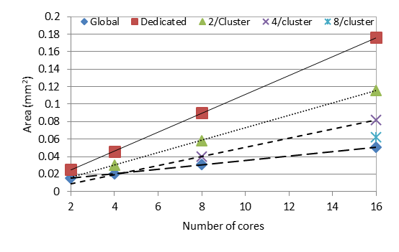
Power and Area Trends
Power
Area
Power-of-two increase:
Global tuner = 49%
Dedicated tuners = 89%
Clustered tuners = 111%
Power-of-two increase:
Global tuner = 51%
Dedicated tuners = 93%
Clustered tuners = 100%
Linear increases: scalability of all layouts to future systems

Slide 15
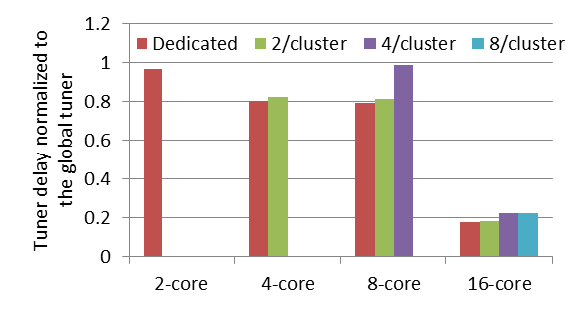
Tuning Delay
Average reduction normalized to global tuner:
Dedicated tuners = 3%, 20%, 21%, and 82% in 2-, 4-, 8-, 16-core systems, respectively
2/cluster tuners = 17%, 18%, 82% in 4-, 8-, 16-core systems, respectively
4/cluster tuners = 1% and 78% in 8- and 16-core systems, respectively
8/cluster tuners = 77% in 16-core system
Small clusters reduce bottleneck in large systems

Slide 16
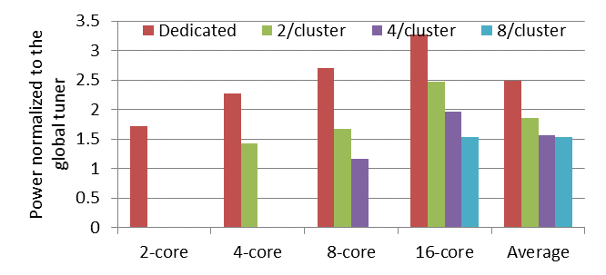
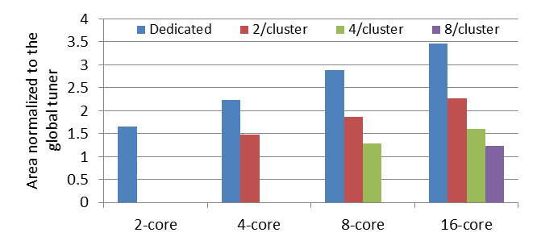
Power/Area Compared to Global Tuner
Power
Area
Power increase:
Dedicated tuners = 149%
2/cluster tuners = 86%
4/cluster tuners = 56%
8/cluster tuners = 53%
Area increase:
Dedicated tuners = 156%
2/cluster tuners = 87%
4/cluster tuners = 44%
8/cluster tuners = 23%
Clustered tuners can provide good tradeoff in large systems

Slide 17
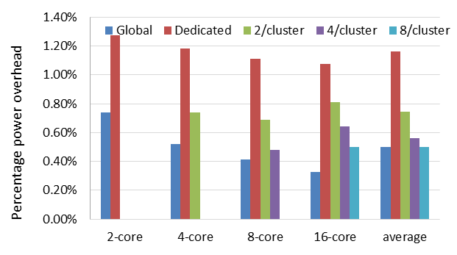
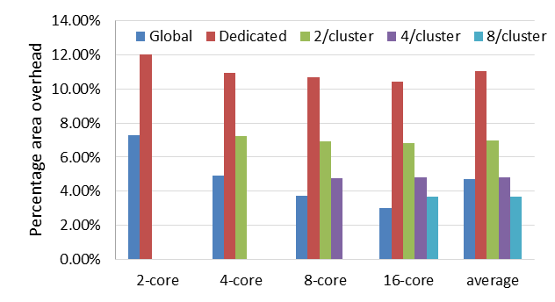
Overheads Imposed on Microprocessors
Compared to MIPS32 M14K 90nm processor: 12mW power at 200 MHz; 0.21mm² area
Power
Area
Global = 0.5%
Dedicated tuners = 1.16%
Clustered tuners = 0.6%
Global = 4.73%
Dedicated tuners = 11.03%
Clustered tuners = 5.17%
Our cache tuners constitute minimal overhead!

Slide 18
Conclusions
Cache tuning specializes system’s cache configuration to varying application requirements
Cache tuner must constitute minimal power, performance, and area overhead
We presented low overhead cache tuners
Options: global, dedicated, and clustered tuners
Scales to multiple cores
Designers can select appropriate cache tuners based on design objectives
Clustered tuners provide tradeoffs
Analysis applicable to other tuning scenarios
Future work
Evaluate cache tuners in up to 128 cores
Incorporate lightweight communication network on cache tuner
Independent of on-chip communication network

Slide 19
Questions?

