Slide 1
An Automated Hardware/Software Co-Design
Flow for Partially Reconfigurable FPGAs
Ann Gordon-Ross
Associate Professor, University of Florida Department of Electrical and Computer Engineering
Shaon Yousuf*
University of Florida Department of Electrical and Computer Engineering *Currently affiliated with Intel Corporation

Slide 2
Efficient Embedded System Design
Modern SRAM-based FPGAs provide partial reconfiguration (PR)
Reconfigures isolated FPGA regions
Partially reconfigurable region (PRRs)
Only interrupts execution in reconfigured PRR
PR enables efficient embedded system design
Multiplex mutually exclusive application tasks in PRRs
Reduces system area, memory, power requirements
PRR 1
T1
T1, T2, T3 required -
Load T1 to PRR1,
load T2 to PRR2,
Load T3 to PRR 3
T1
running
Time S1
T2
PRR 2
T3
T2
running
T4
T1, T2, T4 required -
load T4 to PRR3, T1 and T2 uninterrupted
Time S2
T5
PRR 3
T6
T4
running
T4, T5, T6 required
load T5 to PRR1, load T6 to PRR 2,
T4 uninterrupted
Application Tasks
Time S3
FPGA Fabric
Notes:
Time(min): 1:30
Total(min): 1:30

Slide 3
Efficient Embedded System Design
Cutting edge PR-capable FPGAs can also contain software processors
Enables designing hardware/software (HW/SW) hybrid systems
Tasks execute in software and/or hardware
Further reduces area requirements
Designing hybrid systems is complex
Difficult to leverage PR benefits effectively – known as a HW/SW co-design problem
Software Processor
T1 & T2
running
T1
T5 & T6
running
T1, T2, T3 required -
T1 and T2 runs in software,
Load T3 to PRR 2
T2
Time S1
PRR 2
T3
T1, T2, T4 required –
T1 and T2 still running in software,
load T4 to PRR2
T4
running
T4
Time S2
T5
Area Savings
T6
T4, T5, T6 required
T5 and T6 runs in software,
T4 uninterrupted
Application Tasks
Time S3
FPGA Fabric
Notes:
Time(min): 1:30
Total(min): 3:00

Slide 4
Traditional HW/SW Co-design for PR Systems
HW/SW co-design of PR systems requires specialized design flow
HW/SW PR partitioning allocates tasks into software and hardware, and allocates/maps hardware tasks into one or more PRRs
PR design floorplanning determines physical placement of PRRs and PRR boundary communication interfaces (partition pins)
Place and route, and final bitstream generation follows
PR partitioning and PR floorplanning are performance critical steps
Chosen PR partition affects resource requirements and number of reconfigurations required (reconfiguration time)
PR floorplan directly affects overall design speed (clock frequency)
Application
Tasks
HW/SW PR Partitioning
Chosen
HW/SW PR partition
PR design Floorplanning
Place and Route Design
Performance critical steps
Generate Final
Design
Bitstreams
Notes:
Time(min): 1:00
Total(min): 4:00

Slide 5
HW/SW PR Partitioning Challenges
Many possible PR partitions
Partition A requires more PRRs = more hardware requirements
Partition B requires more reconfigurations = more reconfiguration time
Challenge: Choose PR partition that meets system designer goals wrt hardware requirements and reconfiguration time tradeoff
PRR 1
T1
PRR 2
T2
T1
FPGA Hardware
HW Tasks partitioned into 2 PRRs
T2
T3
SW Processor
T3,T4,T5
T4
FPGA Software
Partition A
T5
T3
FPGA Hardware
HW Tasks partitioned into 1 PRRs
PRR 1
T3, T4, T5
T4
T5
SW Processor
T1, T2
T1
FPGA Software
Partition B
T2
Notes:
Time(min): 0:30
Total(min): 4:30

Slide 6
PR Design Floorplanning Challenges
Many possible PRR and partition pin floorplans
Each floorplan has different total wire length and affects design clock frequency
Example - Floorplan A with less wire length is faster that Floorplan B
FPGA resource and clocking resource locations, and distance from input/output (I/O) interfaces also affects design clock frequency
Challenge – Find PR design floorplan that meets system designer goals wrt to clock frequency
FPGA Fabric
FPGA Fabric
HW PRR 1
T1
HW PRR 2
T2
HW/SW PR partition A Chosen
Hardware Allocation – T1, T2
Software Allocation –
T3, T4, T5
HW PRR 1
T1
HW PRR 2
T2
SW Processor
T3,T4,T5
Requires more total wire length than Floorplan A
SW Processor
T3,T4,T5
PR Design Floorplanning
Partition A: Floorplan A
Partition A: Floorplan B
Partition Pins
Notes:
Time(min): 0:30
Total(min): 5:00

Slide 7
Design Automation for HW/SW Co-design
We present
Design Automation for Partial Reconfiguration (DAPR) design flow to aid embedded system designers with HW/SW co-design challenges
Performs automated HW/SW PR partitioning
Automatically explores design space using an exhaustive search
Designer chooses HW/SW PR partition that meets required goals
Performs automated floorplanning on chosen HW/SW PR partition
Automatically explores design space using a simulated annealing-based heuristics
Leverages vendor tools to automatically output final design bitstreams
Application
Tasks
Automated Partitioning
Chosen
HW/SW PR partition
Automated Floorplanning
Final
Design
Bitstreams
Determines PR partitions with reconfiguration time vs. area requirement tradeoffs
DAPR Design Flow
Works towards improving the clock frequency of the PR partition
Notes:
Time(min): 1:00
Total(min): 6:00

Slide 8
Overview of Contributions
Automated design flow for efficient HW/SW PR co-design of PR systems
Automated exhaustive search-based methodology of HW/SW PR partitions
Partitions tradeoff reconfiguration time vs. area requirements
Total system execution time for partitions is also reported
Automated simulated annealing-based PR design floorplanning methodology
Improves clock frequency to approximately 10% of the highest achievable clock frequency between 12-20 iterations on average
Supports PR-capable Virtex-4, 5, 6, and 7 devices
Generalized, thus easily extendable to any PR-capable device
DAPR design flow benefits
Simple and holistic PR design flow that requires minimal design intervention
Makes PR benefits easily attainable and amenable to designers
Notes:
Time(min): 1:00
Total(min): 7:00

Slide 9
DAPR’s Initial Analysis
PR system design is modularized in nature
Application divided into tasks
Application task flow graph represents application functionality
PR systems change during runtime
Can have multiple task flow graphs (configurations) [Vipin et al. 2013]
T1
T1
T1
T2
T2
T3
T4
T3
T3
T4
T4
T1
T2
T1
T5
Modularized Application Tasks
T5
T5
Configuration 0
Configuration 1
Notes:
Time(min): 0:30
Total(min): 7:30

Slide 10
DAPR’s Initial Analysis
To evaluate each configurations performance we define
Ti_{i} – List of application tasks
CO_{i} – List of tasks required in configuration i
RR_{i} -Task i’s resource requirements
Estimated from HDL synthesis using vendor tools
TR_{i} - Task i’s reconfiguration time
Estimated from number of frames required to reconfigure task
Frames is the smallest addressable unit of an FPGA
Reconfiguration time corresponds to total number of frames multiplied by device reconfiguration speed
CI_{i} - Task i’s software and hardware execution times
Estimated by calculating total mathematical operations in a task (addition, subtraction, multiplication, division)
Multiplied by operation’s HW/SW clock cycle latency
Total clock cycle requirements correspond to execution times
Notes:
Time(min): 0:30
Total(min): 8:00

Slide 11
HW/SW PR Partitioning Methodology
Leverages configuration list and modularized application
Determines T_{i},RR_{i}, TR_{i}, and CI_{i} performance parameters
HW/SW PR algorithm generates all possible HW/SW PR partitions and corresponding partitions performance results
Resource requirements, reconfiguration time, and HW/SW execution time reported
System designer analyzes results, selects Chosen HW/SW PR partition
Chosen HW/SW PR partition undergoes DAPR’s SA-based PR floorplanning
Configuration List, COi
Estimate T_{i} RR_{i}, TR_{i}, and CI_{i}
HW/SW partitions and performance results
HW/SW PR Partitioning Algorithm
Modularized
Application
Analyze and select Chosen HW/SW partition
Notes:
Time(min): 1:00
Total(min): 9:00

Slide 12
Automated Floorplanning Algorithm
Iteratively improves HW/SW PR partition’s floorplan
Leverages simulated annealing (SA)-based algorithm
PRR floorplan is improved first
PRR floorplan changes have largest affect on design performance
Partition pin floorplan is improved over last few iterations
DAPR SA-based algorithm overview
Evaluates PRR floorplan using an improved perturbation function
New operation changes floorplan starting locations
Evaluates partition pin floorplan with a new perturbation function
Tailored specifically for partition pin placement exploration
Notes:
Time(min): 0:30
Total(min): 9:30

Slide 13
DAPR SA-based PRR Floorplanning
Typical PR design floorplanning methods bounds static regions
Static region routing constrained to bounded region
Floorplanning performed considering static region as a PRR
DAPR SA-based PRR floorplanning allows unbounded static regions
Relaxes static region routing to reveal faster clock frequency designs
New perturbation function enables unbounded static regions
Floorplan starting locations changed after all PRR permutations is satisfied
Bounded floorplan
Unbounded Floorplan A
Unbounded Floorplan B
Unbounded Floorplan C
PRR 1
PRR 2
Static Region
Static Region
PRR 2
PRR 3
PRR 2
PRR 3
PRR 2
PRR 3
PRR 3
PRR 4
PRR 1
Static
Region
Static Region
PRR 1
PRR 4
PRR 4
PRR 1
PRR 4
Static Region
Static Region
Different PRR floorplan starting locations
Notes:
Time(min): 0:30
Total(min): 9:30

Slide 14
DAPR SA-based Partition Pin Floorplanning
Partition pin floorplan is represented as list, P = {1,2,3 …., n}
List number represents partition pin
List index represents partition pin placement with respect to neighbors
Improves partition pin floorplan iteratively with a novel perturbation function tailored for partition pin floorplanning
OP1: Randomly place partition pins around PRR
OP2: Switch adjacent input pin placements
OP3: Switch adjacent output pin placement
OP4: Switch adjacent input and output pins
PRR
Notes:
Time(min): 0:30
Total(min): 10:00

Slide 15
DAPR Design Flow Evaluation
Experimental Setup
Software
HW/SW PR partitioning algorithm written in PERL
Xilinx ISE 14.7
Hardware
Virtex-5 LX110T FPGA
4rth generation Intel® Core™ 7 2.5 GHz CPU and 8 GB of RAM
Test design
JPEG encoding/decoding application
Next slides present
CO_{i}, RR_{i}, TR_{i}, CI_{i} estimations
Maximum resource requirements, reconfiguration time, and software execution time results
Notes:
Time(min): 0:20
Total(min): 10:20

Slide 16
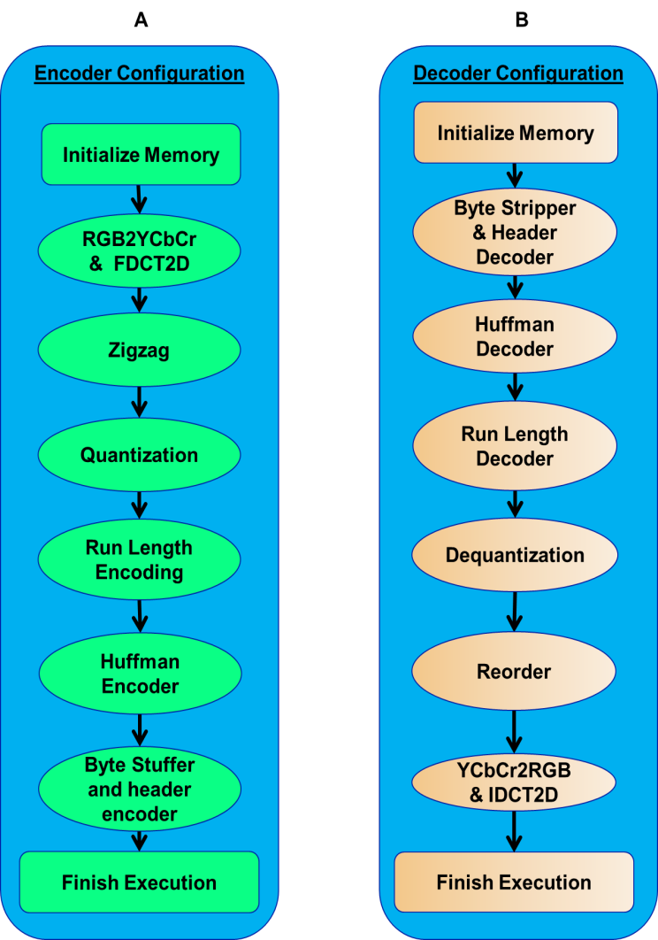
JPEG CODEC Configurations
Two configurations
Configuration A – JPEG encoding process
Configuration B – JPEG decoding process
All tasks change between configurations
Each configuration will have different requirements for each HW/SW PR partition
Total resource requirements, reconfiguration time, and execution time will be different
Enables accurate analysis of our HW/SW PR partitioning methodology
Notes:
Time(min): 0:40
Total(min): 11:00

Slide 17
JPEG CODEC Resource Requirements
 | Resource requirements, RR_{i}
Task List | CLBs | DSPs | BRAMs
RGB2YCbCR and FDCT | 406 | 7 | 5
YCbCrtoRGB and IDCT | 400 | 7 | 5
Run Length Encoding | 42 | 0 | 2
Run Length Decoding | 42 | 0 | 2
Huffman Encoder | 280 | 1 | 2
Huffman Decoder | 350 | 1 | 2
Byte Stuffer and header encoder | 14 | 0 | 1
Byte Stripper and header decoder | 14 | 0 | 1
Quantization | 14 | 2 | 3
Dequantization | 14 | 2 | 3
Zigzag | 14 | 0 | 2
Reorder | 14 | 0 | 2
Notes:
Time(min): 0:20
Total(min): 11:20

Slide 18
JPEG CODEC Reconfiguration Times
Device reconfiguration speed is approximately 234MB/s [Liu et al 2009]
Task List | Reconfiguration time, TR_{i} (Frames)
RGB2YCbCR and FDCT | 1650
YCbCrtoRGB and IDCT | 1600
Run Length Encoding | 480
Run Length Decoding | 480
Huffman Encoder | 1000
Huffman Decoder | 1100
Byte Stuffer and header encoder | 100
Byte Stripper and header decoder | 100
Quantization | 170
Dequantization | 170
Zigzag | 120
Reorder | 120
Notes:
Time(min): 0:20
Total(min): 11:40

Slide 19
JPEG CODEC Execution Times
SW runs on VAPRES Micro Blaze softcore processor
Clock cycles – Add =1, subtract =1, divide = 3, and multiply = 34 *
HW runs on FPGA
Clock cycles – Add =1, subtract =1, divide = 1, and multiply = 1*
 | Execution times, CI_{i}
Task Name | SW Execution (cycles) | HW Execution (cycles)
RGB2YCbCR and FDCT | 40,000 | 10,000
YCbCrtoRGB and IDCT | 42,000 | 10,000
Run Length Encoding | 10,000 | 2,000
Run Length Decoding | 10,000 | 2,000
Huffman Encoder | 25,000 | 10,000
Huffman Decoder | 30,000 | 10,000
Byte Stuffer and encoder | 20 | 20
Byte Stripper and header decoder | 20 | 20
Quantization | 40 | 40
Dequantization | 40 | 40
Zigzag | 40 | 40
Reorder | 40 | 40
* Taken from Xilinx DS100 2009
Notes:
Time(min): 0:20
Total(min): 12:00

Slide 20
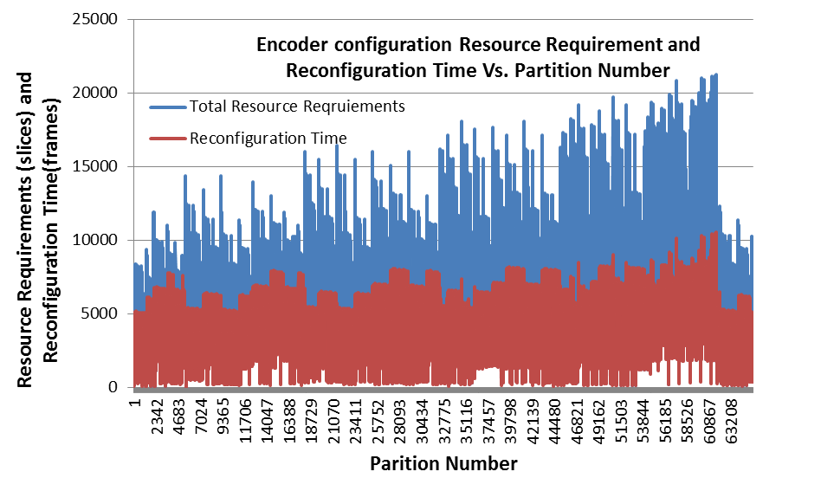
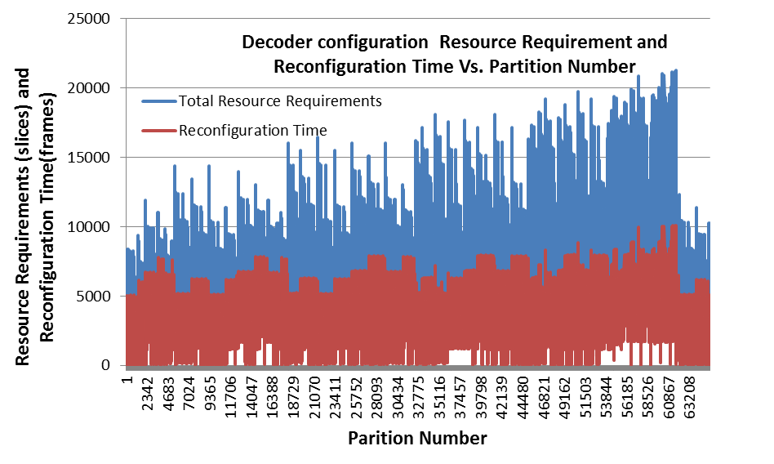
Results: HW/SW Partition Exploration
Partitions with low resource requirement and reconfiguration time
Notes:
Time(min): 1:00
Total(min): 13:00

Slide 21
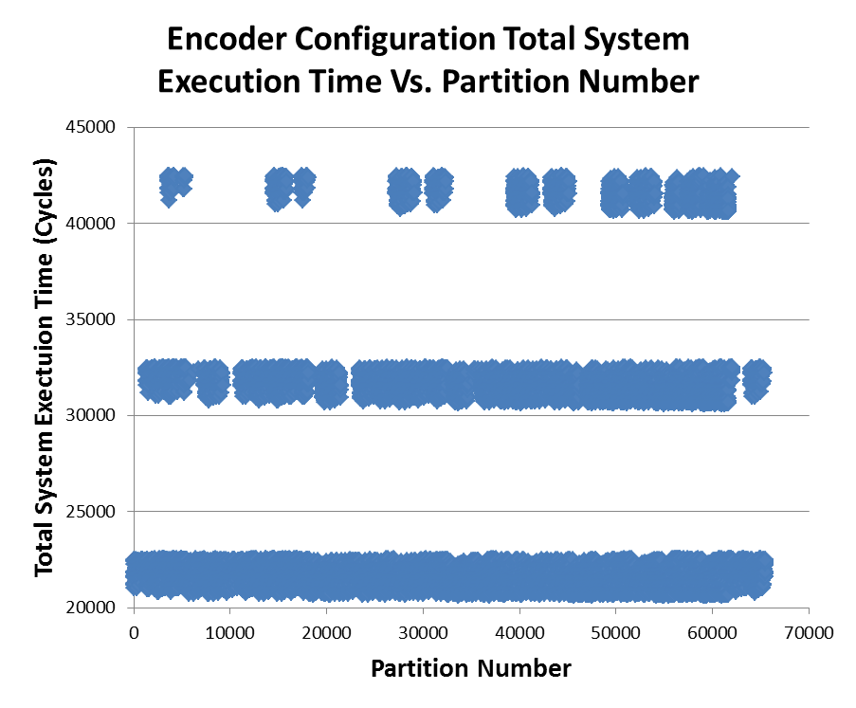
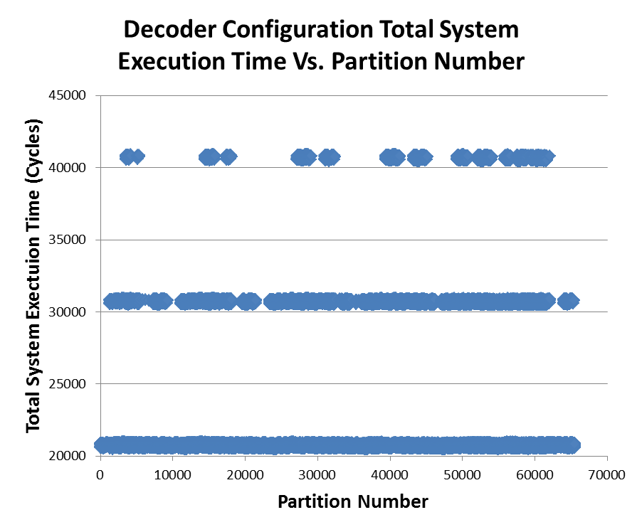
Results: HW/SW Partition Exploration
Partitions with low total execution time
Notes:
Time(min): 1:00
Total(min): 14:00

Slide 22
Results: HW/SW PR Partition Selection
Example system designer requirements for both configurations
Resource requirements 12,000 slices, reconfiguration time 9000 frames, and total system execution 25,000 cycles
Choose any HW/SW PR partition between 1-1000
HW/SW PR partitions that meet system designer goals
Notes:
Time(min): 1:00
Total(min): 16:00

Slide 23
Results: JPEG Codec Design Space Exploration
Due to simulated annealing’s initial random exploration, 3 different floorplan runs are shown
Solution improves with successful iterations (highlighted circle)
Growth rate quickly levels off to within 1.8 % of the highest achievable within average of 20 iterations
Notes:
Time(min): 1:00
Total(min): 17:00

Slide 24
Conclusions and Future Direction
We presented the DAPR design flow
Determines HW/SW PR partitions that tradeoff resource requirements and reconfiguration time
Designers choose a HW/SW PR partition that satisfy system design goals
Leverages a novel simulated annealing based algorithm to improve the clock frequency of the HW/SW PR design partition
The DAPR design flow alleviates intricacies involved in HW/SW co-design of PR-based embedded systems by automation
DAPR design flows makes PR design more accessible and amenable to a wide range of system designers
Future directions
Improve DAPR design flows HW/SW PR partitioning methodology’s estimation technique for hardware/software execution time calculation
Leverage an application profiler
Explore techniques to improve DAPR design flows PR design floorplanning
Enhance portability of DAPR design flow to Altera Devices
Notes:
Time(min): 1:00
Total(min): 18:00

Slide 25
QUESTIONS?
This work was supported in part by the I/UCRC Program of the National Science Foundation under Grant No. EEC-0642422. We also gratefully acknowledge tools provided by Xilinx.

