Slide 1
Realizing Closed-loop, Online Tuning and Control for Configurable-Cache Embedded Systems: Progress and Challenges
Islam S. Badreldin*, Ann Gordon-Ross*, Tosiron Adegbija§, and Mohamad Hammam Alsafrjalani⁺
Department of Electrical & Computer Engineering
*University of Florida, §University of Arizona, ⁺University of Miami
{ibadreldin,anngordonross}@ufl.edu, tosiron@email.arizona.edu, alsafrjalani@miami.edu

Slide 2
Introduction and Motivation
Embedded systems have become ubiquitous
Stringent design constraints: energy, performance, Quality of Experience (QoE) expectations, cost
Increasingly complex memory and compute requirements
Must operate in unknown and changing environments, and demands
Application characteristics
User expectations
Feature complex heterogeneous processors to satisfy execution demands and diversity

Slide 3
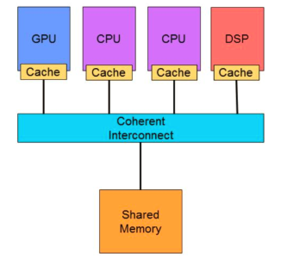
The Cache Subsystem
Caches can consume up to 50% of total processor power
Cache optimization more important in heterogeneous multicore systems
Caches must be adaptable to varying execution demands, environments, and user QoE expectations/feedback
I.e., configurable caches
Cache design space becomes extremely large when considering QoE expectations
Cache tuning becomes more complex

Slide 4
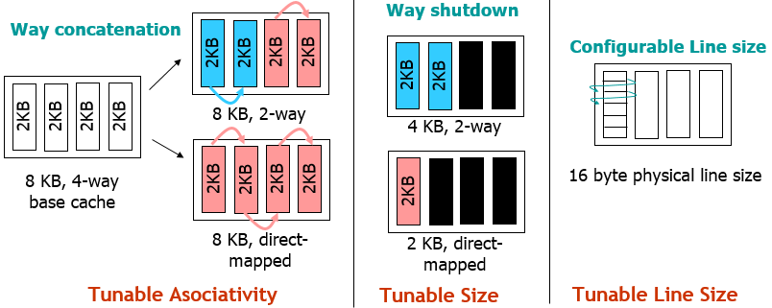
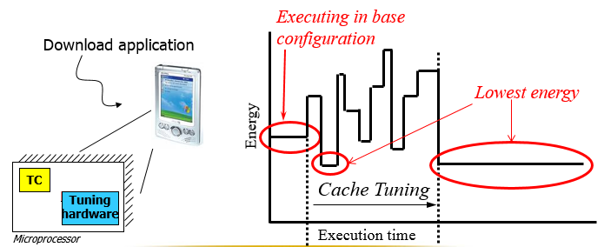
Configurable Caches

Slide 5
Cache Tuning in Heterogeneous Cores
New dynamic cache tuning methods required
When to reconfigure the cache
Incorporating runtime time-varying user QoE expectations
User-defined optimization metrics
Data sharing, cache coherence, etc.
Impact of cache tuning on user experience
Must not degrade user experience during cache tuning
Need online, closed-loop, user-aware cache tuning systems

Slide 6
Overview of Cache Tuning Methods
Cache tuning
(Design space exploration)
Offline DSE
Online DSE
Simulation-based
Subsetting
Heuristics
Analytical methods
Static configs
Near-optimal configs
Explore 1% of design space
Eliminate DSE

Slide 7
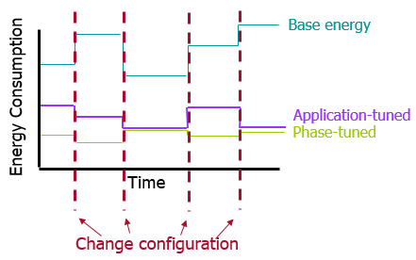
Problem Formulation
Set of n applications
$$A=\{a_{1}, a_{2},…, a_{n}\}$$
Set of m possible cache configurations
$$C=\{c_{1},c_{2},…, c_{m}\}$$
Set of k_{i} application phases per application a_{i}
$$P_{a_{i}}=\{p_{1},p_{2},…, p_{k_{i}}\}$$
Energy-related optimization metric
$$e(a_{i},p_{k},c_{j})$$
Performance-related optimization metric
$$u(a_{i},p_{k},c_{j})$$
Pareto-optimal design $c_{0}∈C s.t.$
$e\left(a_{i},p_{k},c_{0}\right)≤e\left(a_{i},p_{k},c_{j}\right)$ with ‘<‘ for some $c_{j}$
& $u\left(a_{i},p_{k},c_{0}\right)≤u\left(a_{i},p_{k},c_{j}\right)$ with ‘<‘ for some $c_{j}$
Energy
Pareto
optimal designs
Execution time

Slide 8
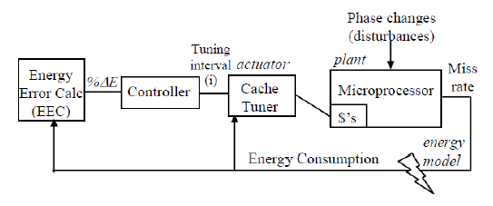
Online Cache Tuning and Control
Goal: continuously monitor and adapt to changing user and environment requirements
Must be transparent to both user and application
Need a feedback control system for self-monitoring and online adjustment
Requirements of a self-tuning cache system
1. Monitor and collect information about system behavior
2. Dynamically reconfigure tunable parameter values
3. Determine when to change configurations in response to phase changes without incurring significant penalties
4. Adapt to user QoE expectations; limit QoE degradation

Slide 9
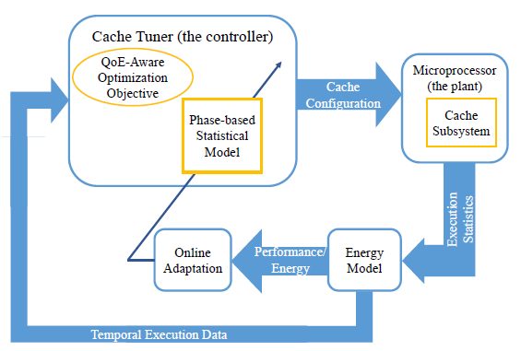
Proposed Ideal Self-Tuning Cache System
Notes:
Controller (tuner): incorporates QoE awareness; phase-based statistical model (linear/non-linear adaptive filters)
Temporal execution data: consider history of execution statistics and performance metrics as time series
No need to explicitly perform phase classification
Operate at high temporal resolution while dynamically tuning interval
Plant (cache subsystem): single level, multilevel, multicore

Slide 10
Challenges of Online Cache Tuning and Control
Avoiding QoE degradation due to DSE overheads
→ use analytical and prediction-based models to limit the DSE to a few best options
Performing well even for applications that are unknown at design time
→ use online adaptation and control to update the model data in real-time
Operating at an optimal tuning interval
→ operate at high temporal resolution using online filtering while dynamically adjusting the tuning interval
Tracking variations in QoE expectations
→ incorporate sensor values and historical data to directly predict best configurations given an estimated QoE expectation
Incorporating user feedback
→ combine both intrusive and non-intrusive techniques to solicit user feedback to identify what the user considers a best configuration

Slide 11
Conclusions
Efficient self-tuning caches critical for emerging resource-constrained computers
May operate in unknown environments
Wide variety of applications
Different kinds of users may require different kinds of runtime tuning
Several challenges exist for realizing self-tuning cache that is transparent to both the user and the executing applications
Minimizing DSE overheads
Self-tuning for unknown applications
Meeting user QoE expectations
Etc.
Future work: explore proposed ideal architecture towards addressing the challenges
Use an online, adaptive statistical model to predict best configuration given historical data, user feedback, sensor readings, etc.
QoE-aware optimization, and dynamic adjustment of the tuning interval

