Slide 1
Topology Design and Performance Analysis for Networked Earth Observing Small Satellites
November 9th, 2011
Dr. Janise McNair,
Paul Muri
Wireless and Mobile (WAM)
Systems Lab
www.wam.ece.ufl.edu
Dr. Ann Gordon-Ross,
Joe Antoon
NSF Center for High Performance
Reconﬁgurable Computing (CHREC)
www.chrec.org
Dr. Norman Fitz-Coy,
Kathryn Cason
Space Systems
Group (SSG)
www.mae.ufl.edu/ssg/
Notes:
Introduction
Topology Design and Performance Analysis for Networked EO Small Satellites

Slide 2
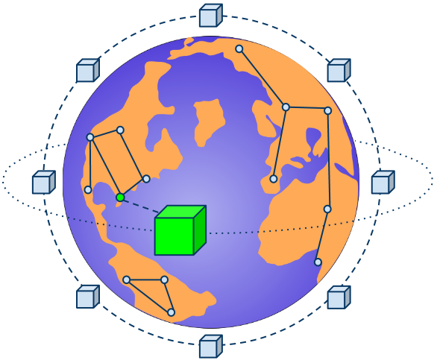
Agenda
Project Outline
Distributed Satellite System Taxonomy
STK Constellation Network Performance
Application, Constellations, Orbital Parameters
NS-2 Simulations
Exporting STK, Propagation Model, MAC parameters
Simulation Results
Access windows, Packet Drop Ratio, Throughput
Conclusions and Future Work

Slide 3
Project Outline
Problem
No known studies of network performance for LEO Constellations
No method of simulation for LEO constellation with customized network specifications
Goals
Determine optimized satellite constellation topology
Optimized network parameters for 802.11
Compare SSRGT network metrics with flower
Products
Creation of a novel SSRGT constellation for LEO
Optimized MAC parameter for the SSRGT and flower constellations
Created method and scripts for exporting STK designed constellation into NS-2

Slide 4
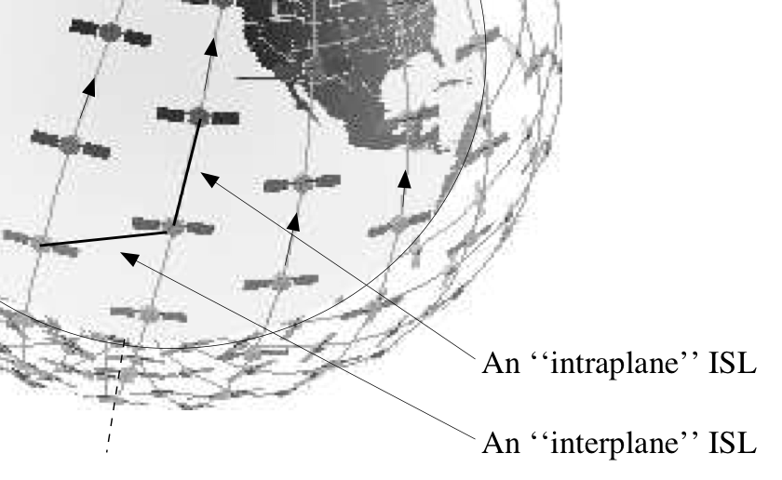
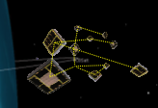
Distributed Satellite System Taxonomy
Distributed Satellite Systems
Constellation
Cluster
Crosslinks
Ground Links
Formation Flying
Free Flying
Ph D Thesis 2008 Barnhart – Very Small Design for Space Sensor Networks

Slide 5
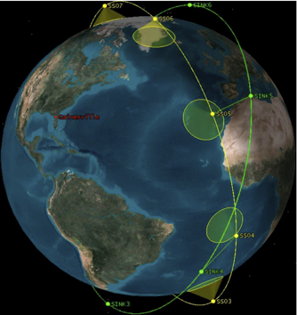
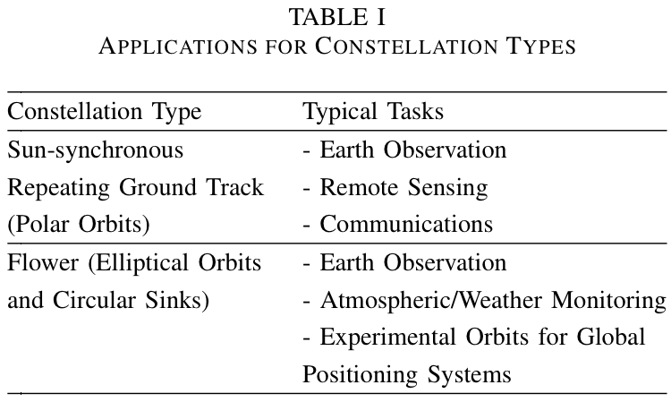
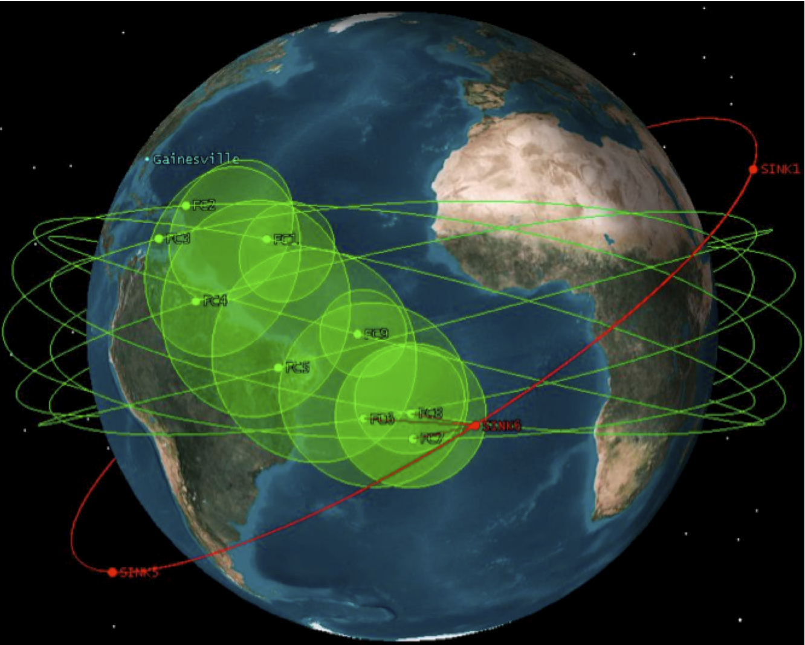
STK Constellation Network Performance
Repeating Ground Track
Flower Constellation, benchmark
Notes:
Limitations of SS LEO Constellations
Distributed Topology Management (LEO Constellations)
Slow downlink datarates (SS)
Single p2p communications (SS LEO Constellations)
To see if a specific SS LEO Const application is achievable, simulation of network performance is required.
Sun-synchronous repeat ground track orbits are already in use for Earth observation and remote sensing missions. It is a particularly prudent orbit type for disaster monitoring, because it offers consistent illumination angles and necessary temporal resolution.
Flower constellations are currently experimental, but their proposed utility lies in Earth observation and atmospheric monitoring. They are traditionally repeat ground track orbits, which is crucial for remote sensing and weather monitoring purposes and can require high temporal resolution.

Slide 6
STK Constellation Network Performance
Goal: Design a CubeSat network constellation
Orbit design with Satellite Tool Kit (STK)
One design uses sun-synchronous repeating ground track
9 sensing nodes are sun synchronous
6 sink nodes are in a circular orbit with inclination of 70°
The benchmark is a flower constellation
Referenced in a Surrey Space Technology Laboratory Study
Repeating Ground Track
Flower Constellation, benchmark
Notes:
Designed network topologies using STK to two LEO EO Constellations
SS RGT
Flower – an elliptical RGT
Sun-synchronous orbit: An orbit which combines altitude and inclination in such a way that the satellite passes over any given point of the planet’s surface at the same local solar time. Such an orbit can place a satellite in constant sunlight and is useful for imaging, spy, and weather satellites.
What makes it RGT?
The orbit was designed so the ground track will repeat after a known period of time.
Both constellations used six sink satellites to provide a high-speed relay that still LEO for low propagation RTT.
Why LEO sinks?
Being small, the sensing satellites are very low power (2 watt max transmission). The sink satellites have to be in close range. Frequency is 2.4 GHz for simulation. Also, shorter propagation at LEO always helps.

Slide 7
STK Constellation Network Performance
Repeating Ground Track
Repeating Ground Track
Flower Constellation, benchmark
Flower Constellation, benchmark
Notes:
Here are the orbit parameters for each constellation studied. The SS RGT is perfectly circular, while the Flower is elliptical for sensing. The sink orbits are both circular, but are at different altitudes to deliver better access time durations. The inclination of sinks orbits were also chosen to deliver more access times between the sensor and sink satellites for both constellations.

Slide 8
NS-2 Simulation
We used NS-2 to simulate satellite networks
Established simulator
Satellite model has few protocols
Mobile model has many protocols
Mobile model has 2-D positioning
Necessary to modify NS-2’s mobile network model to simulate our constellation
Notes:
We used NS-2 to simulate networks between the satellites because it is an established simulator and we are familiar with it.
However, there are several downsides to using NS-2’s satellite model. It does not support elliptical orbits, and does not support any link layer protocols.
To get around these limitations, we used NS-2’s mobile model instead. But, this introduced new problems that required us to modify NS-2.

Slide 9
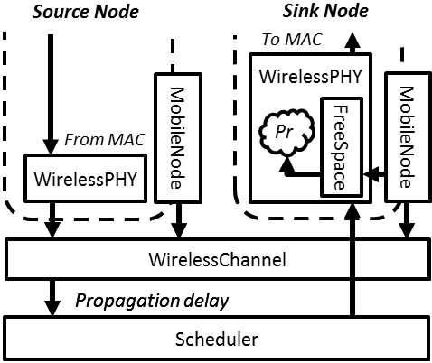
NS-2 Simulation
To model the satellites in STK
Represented satellites as mobile nodes
Set nodes as stationary sidestepping NS-2’s 2D positioning
Exported orbit positions to an
SQLite 3 database
Modified the channel model to use database for node positions
Calculates propagation delay
Modified the propagation model
Calculates received signal strength
Notes:
Plato claimed we can never know truth beyond what our senses tell us.
So to solve our mobile model positioning problem, we left our mobile-node “satellites” standing still in the simulation. Then we changed how they receive signals to be as if they were moving.
We had to modify NS-2 to do this. First, we exported satellite positions from STK into a database.
Then, we modified all the NS-2 models which motion affects to calculate signal propagation using the positions in the database. There were only two models that need to be changed.
The first of these was the signal propagation model, which calculates received signal power. The basic free space path loss model is a reasonable assumption in low-earth orbit.
The second of the modified components was the wireless channel model, which calculates propagation delay. We estimated propagation delay to be the same as for light in a vacuum.

Slide 10
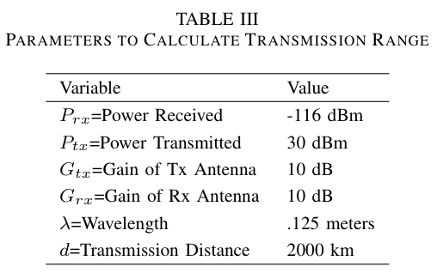
NS-2 Simulation
Propagation models calculate reception power
Uses positions to find inter-node distances
Modified NS2’s FreeSpace propagation model
Accepts positions from STK database
Despite being nearby in NS2’s topography
Packets between distant nodes drop

Slide 11
Experimental Setup
Simulated satellites for one week
6 stationary mobile sink nodes
9 sensing satellites
Network information
802.11b MAC layer
Network traffic sent in uniform UDP bursts
Nodes start transmitting when in range
MAC Parameters:

Slide 12
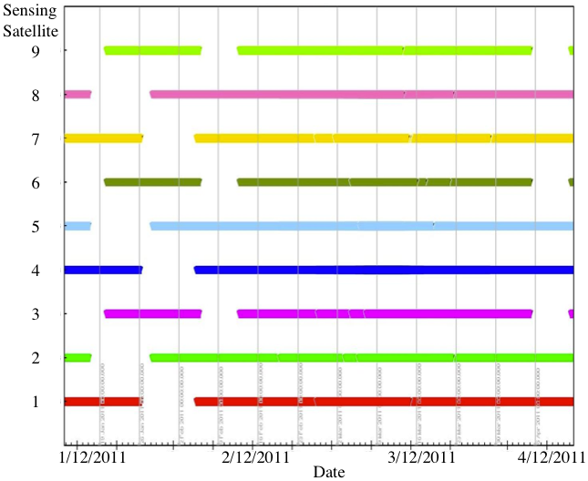
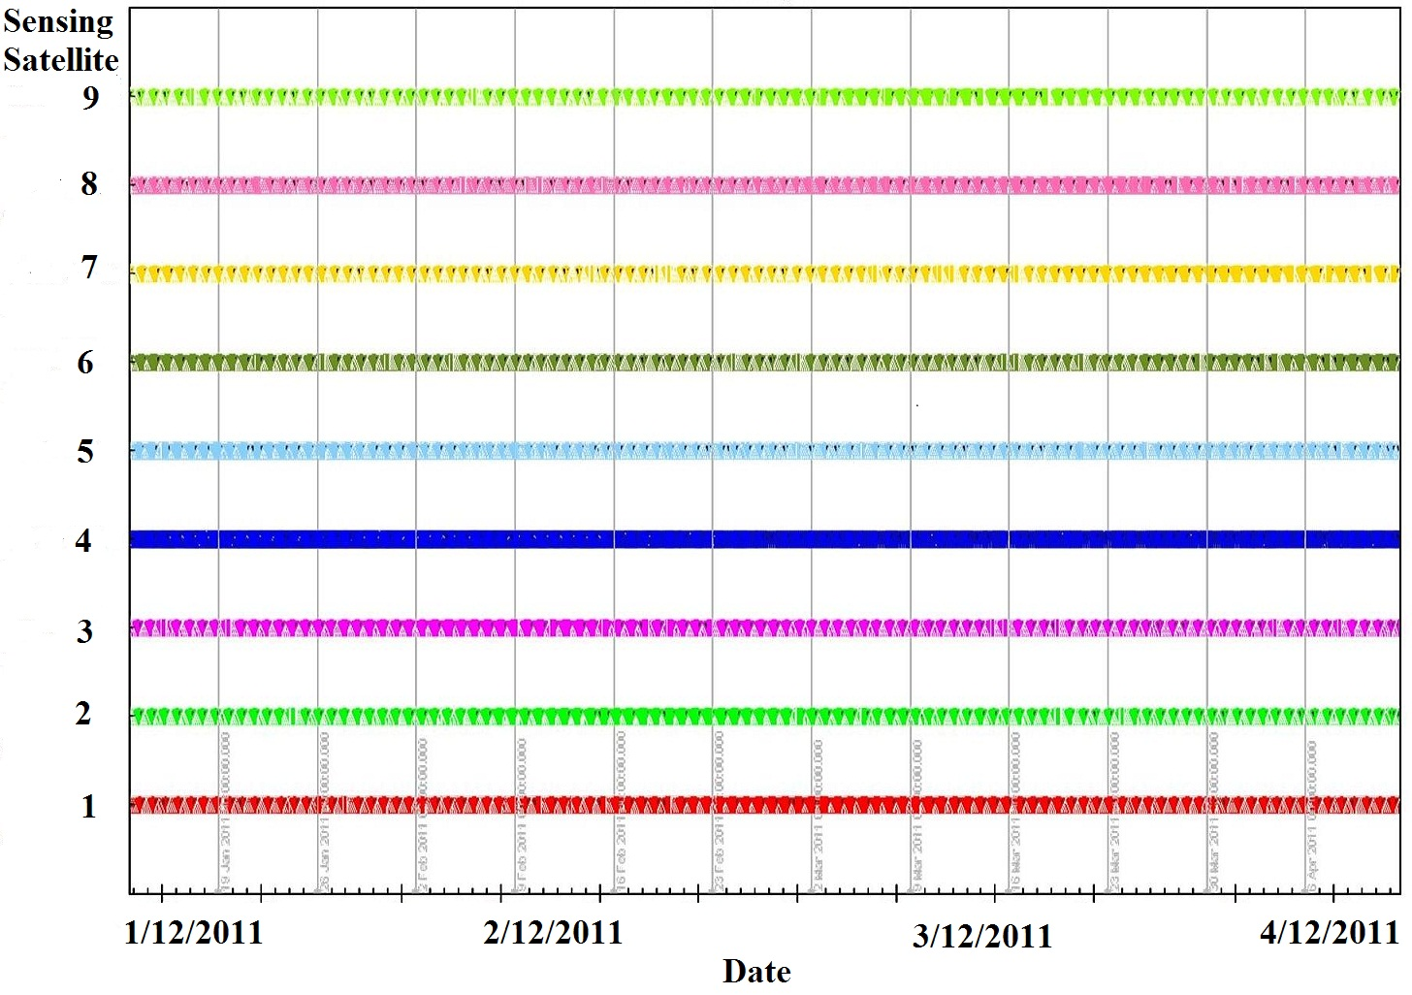
NS-2 Simulation Results
SSRGT
Flower
Access window times between sensing and sink satellite
Three month time span from January 12, 2011 to April 12, 2011

Slide 13
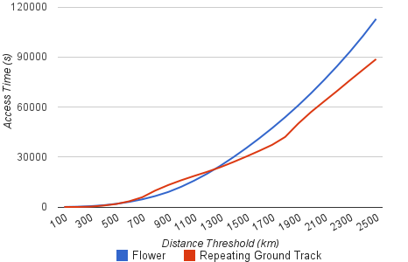
NS-2 Simulation Results
Access window times between sensing and sink satellite
Three month time span from January 12, 2011 to April 12, 2011

Slide 14
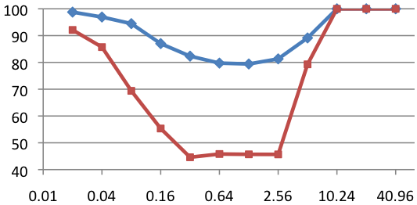
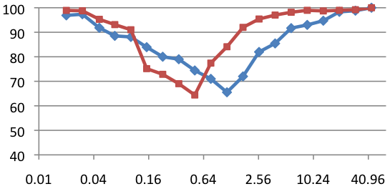
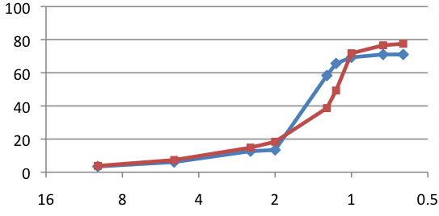
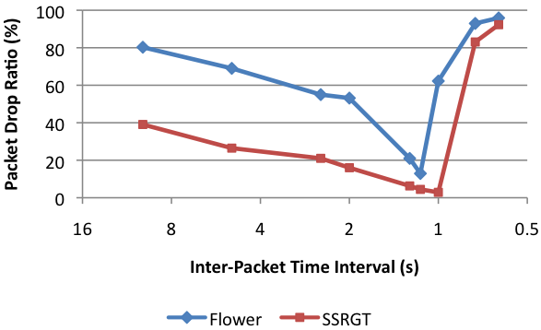
NS-2 Simulation Results
Packet Drop Ratio (%)
Packet Drop Ratio (%)
Source to Sink 802.11 Slot Time (ms)
Sink to Ground 802.11 Slot Time (ms)
Thoughput (kbps)
Packet Drop Ratio (%)
Inter-Packet Time Interval (sec)
Inter-Packet Time Interval (sec)

Slide 15
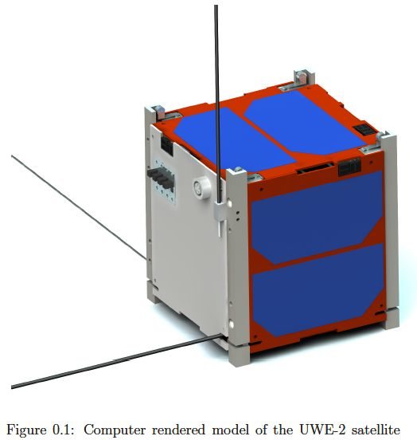
Problem -No known studies of network performance for LEO Constellations
-No method of simulation for LEO constellation with customized network specifications
Contribution -Determined optimized satellite constellation topologies -Optimized network parameters for 802.11 -Compared SSRGT network metrics with flower
Future Work
-Incorporate feedback to find most optimized topology
-Add multiple ground station missions
-Compare networked satellite constellations with clusters

Slide 16
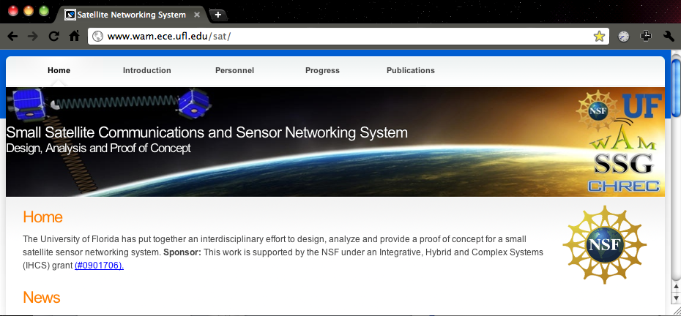
Website
www.wam.ece.ufl.edu/sat/

