Slide 1
An Automated High-level Design Framework for Partially Reconfigurable FPGAs
Rohit Kumar
Dr. Ann Gordon-Ross
{kumar, ann}@chrec.org
Dept. of Electrical and Computer Engineering
University of Florida
Gainesville, FL 32608 USA
This work was supported in part by the I/UCRC program of the National Science Foundation (NSF) under Grant Nos. EEC-0642422 and IIP-1161022 and the NSF CHREC membership support of Draper Laboratory. Any opinions, findings, and conclusions or recommendations expressed in this material are those of the author(s) and do not necessarily reflect the views of the National Science Foundation. We gratefully acknowledge tools provided by Xilinx.

Slide 2
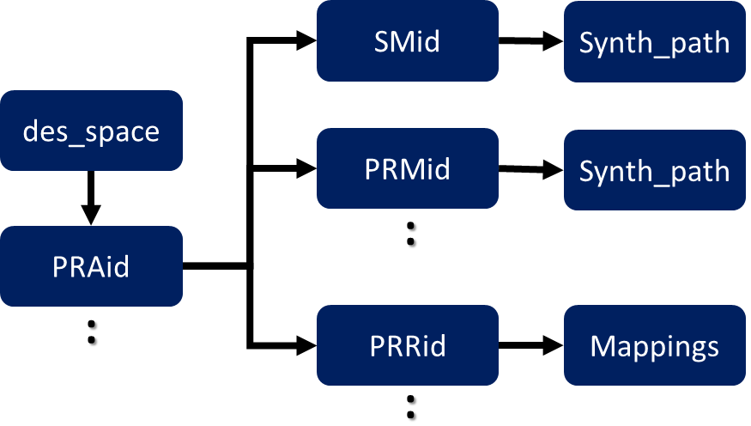
PR Application Development and Our Framework
Partial reconfiguration (PR) benefits:
FPGA resource time-multiplexing via isolated reconfiguration allows area and power savings
PR application development is cumbersome
Application’s HLS code is not amenable to PR but allows rapid application development
Automated PR-specific analysis of HLS code
Create PR-capable application from HLS code
Partial Reconfiguration Amenability Test (PaRAT)
Parse and analyze control and data flow
Infer PR-specific information and combine with control/data flow create PR-specific model
Partition model with PR-specific partitioning techniques to create candidate PR application(s)
Outputs HLS for PR design space exploration
PaRAT flow
HLS output data structure
Please visit our poster for more information and discussion

