Slide 1

A One-Shot Dynamic Optimization Methodology for
Wireless Sensor Networks
Arslan Munir¹, Ann Gordon-Ross¹⁺, Susan Lysecky², and Roman Lysecky²
¹ Department of Electrical and Computer Engineering
University of Florida, Gainesville, Florida, USA
² Department of Electrical and Computer Engineering
University of Arizona, Tucson, Arizona, USA
⁺ Also affiliated with NSF Center for High-Performance Reconfigurable Computing
This work was supported by National Science Foundation (NSF) grant CNS-0834080

Slide 2



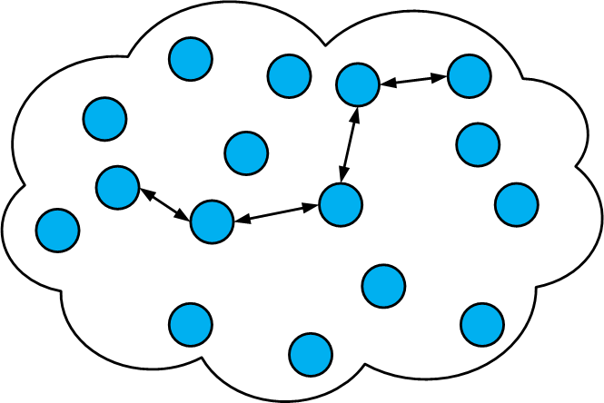

Wireless Sensor Network (WSN) Topology
Network
Application manager
(WSN designer)
Sensor nodes
Gateway node
Sensor field
Sink node

Slide 3


Proliferation of WSNs
Security and
Defense Systems
Industrial
Automation
Ambient conditions
monitoring e.g.
forest fire detection
Health Care
Logistics

Slide 4


WSN Design Challenges
WSN
Design
Forest fire could spread
uncontrollably in the
case of a forest fire
detection application
Failure to meet
Challenges
Catastrophic
Consequences
Meeting application requirements
e.g., reliability, lifetime, throughput,
delay (responsiveness), etc.
Loss of life in the case
of health care application
Application requirements
change over time
Major disasters in the
case of defense systems
Environmental conditions (stimuli)
change over time

Slide 5
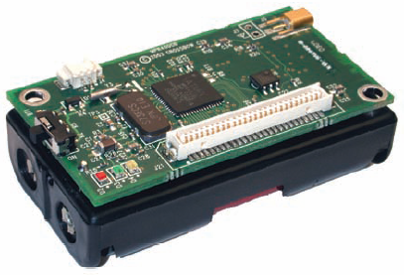
Sensor Node Tunable Parameters
Commercial
off-the-shelf
sensor nodes
Characteristics
Generic Design
Not Application Specific
Few Tunable Parameters
Tunable Parameters
Processor Voltage
Processor Frequency
Radio Transmission Power
Sensing Frequency
Crossbow Mica2 mote

Slide 6
Parameter Optimization
Parameter
Tuning
(Optimization)
Determine appropriate
parameter values (i.e.,
operating state) to meet
application requirements
Challenges
Application managers typically non-experts
e.g. agriculturist, biologist, etc.
Cumbersome and time consuming task
Optimal parameter value selection
given a large design space
Notes:
Give example, such as 100 MHz and sensing frequency of 10 minutes

Slide 7
Parameter Optimization
Parameter
Optimization
Types
Static
Optimization
Dynamic
Optimization
Challenges/
Disadvantage
Assign parameter values at deployment
Stay the same during sensor node lifetime
Assign parameter values at runtime
Reassign/change parameter values
in accordance with changing
application requirements and
environmental stimuli
Difficult to predict/simulate
environmental stimuli
Not suitable for applications with
changing application requirements
and environmental stimuli
Notes:
Gray out static at end of transitions to focus us in on dynamic

Slide 8
Parameter Optimization Example
WSN
Design
Challenges
Dynamic
Optimization
Processor
Frequency
Processor
Voltage
Processor
Frequency
Processor
Voltage
Sensing
Frequency
Sensing
Frequency
High
Power/Energy
High Values
High
Power/Energy
Operating State
High Values
Low
Power/Energy
Low Values
Low
Power/Energy
Operating State
Low Values
Tunable Parameters
Tunable Parameters
WSN designer
Notes:
I have hide the next slide so that you can keep whichever looks better. In this one tortoise is a bit faster but the movement is very smooth. In the next one, the movement is not that smooth =( although it took me a long time to make that one.
Fix annimation

Slide 9
Dynamic Optimization Challenges
Dynamic
Optimization
Processor Frequency
Processor Voltage
Radio Transmission
Power
Sensing Frequency
Challenges
Crossbow Mica2 mote
How to perform dynamic optimization?
Which optimization technique to select?
Formulate an optimization to
perform dynamic optimization
Optimal or near-optimal tunable
parameter values selection

Slide 10
Contributions
Prior research targets
dynamic optimizations for
memory (cache), disk and
processor
in computer systems
Dynamic Optimization
for WSNs
Memory and
energy constraints
Not directly
applicable
A Lightweight Dynamic
Optimization Methodology
Application Metrics
Estimation Model
Additional
Challenges
Unique design space
Relates application metrics (e.g., lifetime)
and sensor-based platform parameters
(e.g., processor voltage and frequency)
Leveraged by dynamic optimization
methodologies to determine high-level
metrics corresponding to an operating state
Memory and energy
constraints
One-Shot:
Determines a good quality
operating state via intelligent
tunable parameter value selection
Operating environment
No design space
exploration required
Non-intrusive

Slide 11
Application Metric Estimation Model
Application Metric
Estimation Model
Can be leveraged by any dynamic
optimization methodology (e.g., One-Shot,
greedy, simulated annealing, etc.,)
to directly determine high-level metric
values corresponding to an operating state
Currently modeled
estimates
Estimates high-level application
metrics from sensor node parameters
(e.g., processor voltage and frequency,
transceiver voltage, etc.)
Application
Metrics
Our model can be extended
to estimate other application
metrics (e.g., responsiveness)
Lifetime
Reliability
Throughput
Time duration between deployment and
sensor node failure (typically due to battery
energy depletion)
Number of packets transferred
reliably (i.e., error free packet
transmission) over the wireless
channel
Rate of the sensing process,
processing, and transmission
to observe a phenomenon

Slide 12

One-Shot Tuning Methodology
Weight factors signify the weightage/importance
of each application metric with respect to each other
Application Metrics and Weight Factors
Application Requirements
Per Sensor Node One-Shot Dynamic Optimization Process
One-Shot:
Initial Tunable
Parameter
Settings
and Exploration
Order
Dynamic
Optimization
Controller
Profiling
Statistics
WSN Designer
Application Metrics Estimation Model
Dynamic
Profiler
Operational Feedback
Operating
State
Exploration order (ascending or descending) helps in further exploration of design space by a lightweight algorithm (e.g., greedy- or simulated annealing-based) for improvement over One-Shot
Set of tunable parameter settings define an operating state

Slide 13

Dynamic Optimization Formulation –
State Space (Design Space)
State Space
  Total number of states in the design space
  Cross product of tunable parameters’ state spaces
  We define state space S as
  where
  = cartesian product
  P_{i} = state space for tunable parameter i
  Each tunable parameter P_{i} consists of n values
  A single n-tuple defines the operating state
    A tunable parameter value setting for each tunable parameter
    E.g., (2.7 V, 4 MHz, 1 sample per second)
Processor Voltage
Processor Frequency
Sensing Frequency

Slide 14



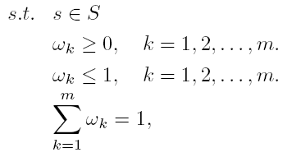
Dynamic Optimization Formulation –
Objective Function
Objective Function
  Defines the goodness of an operating state
  The dynamic optimization problem can be formulated as
  where
  = overall objective function
  = objective function for the k^{th} application metric
  = weight factor for the k^{th} application metric
Dynamic
Optimization
WSN designer

Slide 15
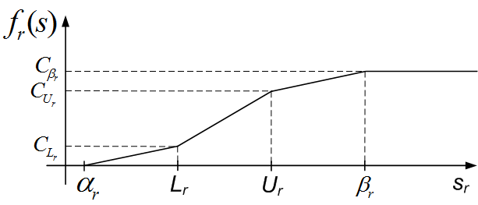
Dynamic Optimization Formulation –
Objective Function
Application Metrics’ Objective Functions
  We consider three application metrics’ objective functions
    Lifetime objective function f_{l}(s)
    Throughput objective function f_{t}(s)
    Reliability objective function f_{r}(s)
  We consider piecewise linear functions which enables user to define desirable and acceptable ranges, e.g.,
Desirable Range
Acceptable Range
= acceptable minimum reliability
= acceptable maximum reliability
= desirable minimum reliability
= desirable maximum reliability

Slide 16
One-Shot Dynamic Optimization Algorithm –
Intelligent Initial Value Settings and Exploration Order
For all Application Metrics
and Tunable Parameters
k^{th} metric objective function
value when tunable parameter
is assigned first tunable value
k^{th} metric objective function
value when tunable parameter
is assigned last tunable value
Select first tunable value p_{i1} as
intelligent initial value setting
Explore tunable parameter in
ascending order
Select last tunable value p_{in} as
intelligent initial value setting
Explore tunable parameter in
descending order

Slide 17
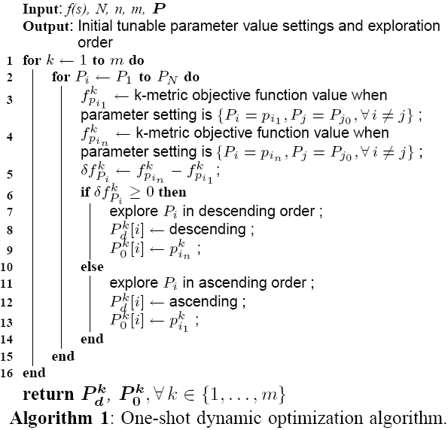
One-Shot Dynamic Optimization Algorithm –
Intelligent Initial Value Settings and Exploration Order

Slide 18

Application Metric Estimation – Lifetime
  The sensor node lifetime in days can be estimated as:
  where E_{b} denotes the sensor node’s battery energy (Joules) and E_{c} denotes the sensor node’s energy consumption per hour
    = + +
    E_{proc}: Processing energy per hour E_{sen}: Sensing energy per hour
  E_{com}: Communication energy per hour
E_{c}
E_{proc}
E_{com}
E_{sen}
Eª_{proc}
E^{i}_{proc}
E^{tx}_{trans}
E^{rx}_{trans}
E^{i}_{trans}
E^{m}_{sen}
E^{i}_{sen}
Processor
active mode
energy
Processor
idle mode
energy
Transceiver’s
transmission
energy
Transceiver’s
receive energy
Transceiver’s
idle energy
Sensing
measurement
energy
Sensing
idle
energy

Slide 19









Application Metric Estimation – Throughput
  The aggregate throughput R (typically measured in bits/second) can be considered as a weighted sum of sensing, processing, and communication throughputs:
  where
  = sensing throughput; = weight factor for sensing throughput
  = processing throughput; = weight factor for processing throughput
  = communication throughput; = weight factor for communication throughput
  where = sensing frequency; = sensing resolution bits;
  where = processor frequency ;
  = number of processor instructions to process one bit;
  where = effective packet size (excluding packet header overhead);
  = time to transmit one packet;

Slide 20
Application Metric Estimation – Reliability
Accurate reliability estimation
requires profiling statistics
of
number of packets transmitted
and number of packets received
Reliability Estimation
Measures the number of packets
transferred reliably
(i.e., error free packet transmission)
Challenges: dynamically changing factors
Main factors affecting reliability
Network topology
Number of neighboring
sensor nodes
Wireless channel fading
Transceiver transmission
power
Sensor network traffic
Receiver sensitivity
Higher transmission power
typically implies higher reliability

Slide 21
Experimental Results
Sensor Node Platform
  Crossbow IRIS mote
    Two AA alkaline batteries
      battery capacity = 2000 mA-h
    Atmel ATmega1281 microcontroller
    MTS400 sensor board
      Sensirion SHT1x temperature and humidity sensors
    Atmel AT-86RF230 low power 2.4 GHz transceiver
Tunable Parameters
  Processor voltage
  Processor frequency
  Sensing frequency
  Packet size
  Packet transmission interval
  Transceiver transmission power
Crossbow Mica2 mote

Slide 22
Experimental Results
Design Space Cardinalities
  |S| = 729
    V_{p} = {2.7, 3.3, 4} (volts)
    F_{p} = {4, 6, 8} (MHz)
    F_{s} = {1, 2, 3} (samples per second)
    P_{s} = {41, 56, 64} (bytes)
    P_{ti} = {60, 300, 600} (seconds)
    P_{tx} = {-17, -3, 1} (dBm)
  |S| = 31,104
    V_{p} = {1.8, 2.7, 3.3, 4, 4.5, 5} (volts)
    F_{p} = {2, 4, 6, 8, 12, 16} (MHz)
    F_{s} = {0.2, 0.5, 1, 2, 3, 4} (samples per second)
    P_{s} = {32, 41, 56, 64, 100, 127} (bytes)
    P_{ti} = {10, 30, 60, 300, 600, 1200} (seconds)
    P_{tx} = {-17, -3, 1, 3} (dBm)
Crossbow Mica2 mote

Slide 23
Experimental Results
WSN Applications
  Security/defense system
  Health care
  Ambient conditions monitoring application
Algorithms implemented in C++ for comparison
  One-Shot and other initial parameter settings as shown in Table below
  Greedy algorithms with different parameter arrangements and exploration orders
  Simulated annealing (SA) algorithm
    provides comparison of one-shot and greedy algorithms with another heuristic
Notation | Description
I | Initial parameter settings from one-shot solution
I₁ | First parameter value for each tunable parameter, i.e., I₁ = p_{i1}, i={1,…,N}
I₂ | Last parameter value for each tunable parameter, i.e., I₂ = p_{in}, i={1,…,N}
I₃ | Middle parameter value for each tunable parameter, i.e., I₃ = floor(p_{in}/2)
I₄ | Random value for each tunable parameter, i.e., I₄ = p_{iq} : q = rand( ) % n

Slide 24
Results – Percentage Improvement
Objective function value improvement attained by I (one-shot) for |S| = 729
Objective function value attained by I (one-shot) for |S| = 31,104
The average percentage improvement attained by one-shot over all application domain and design spaces is 45%
One-shot operating state is within 6% of the optimal on average
Application | I₁ | I₂ | I₃ | I₄
Security/Defense | 155% | 10% | 57% | 29%
Health Care | 78% | 7% | 31% | 11%
Ambient Condition Monitoring | 52% | 6% | 20% | 7%
Application | I₁ | I₂ | I₃ | I₄
Security/Defense | 148% | 0.3% | 10% | 92%
Health Care | 73% | 0.3% | 10% | 45%
Ambient Condition Monitoring | 0% | 76% | 51% | 108%

Slide 25
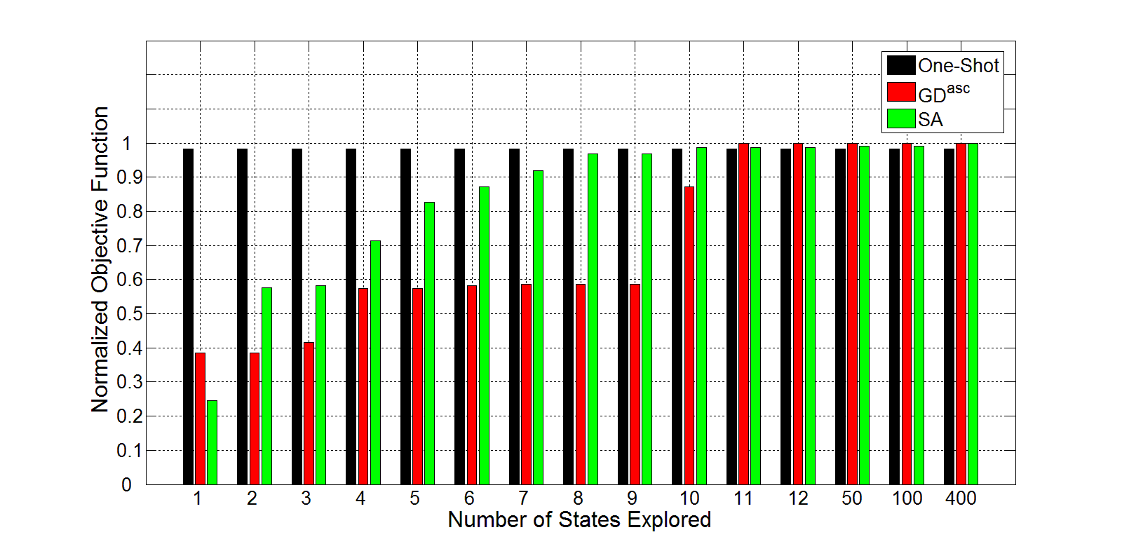
Results – Security/Defense System
Greedy algorithm with ascending order of parameter exploration and initial value setting I₁
GD and SA requires more design space exploration to achieve equivalent or better quality solution than One-Shot’s solution
One-Shot’s solution is within 1.8% of the optimal solution
SA algorithm with initial value setting I₄
Objective function value normalized to the optimal solution for a varying number of states explored for One-Shot, greedy, and SA algorithms for a security/defense system where ω_{l}=0.25, ω_{t}=0.35, ω_{r}=0.4, |S| = 729.

Slide 26
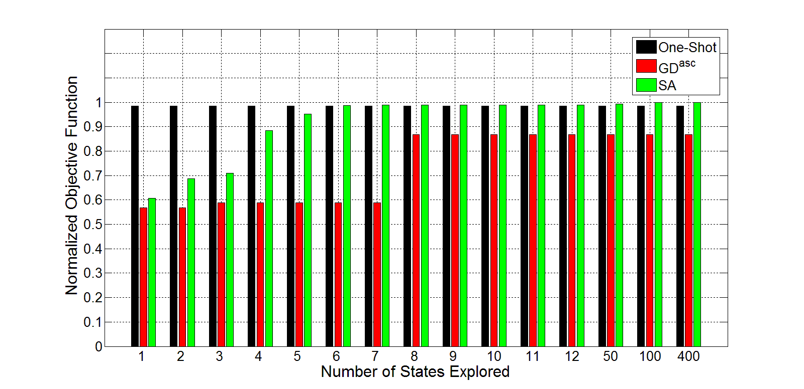
Results – Health Care
One-Shot’s solution is within 1.5% of the optimal solution
GD^{asc} converges to a lower quality solution than the One-Shot solution after exploring 8 states
Objective function value normalized to the optimal solution for a varying number of states explored for One-Shot, greedy, and SA algorithms for a health care application where ω_{l}=0.25, ω_{t}=0.35, ω_{r}=0.4, |S| = 31,104.

Slide 27
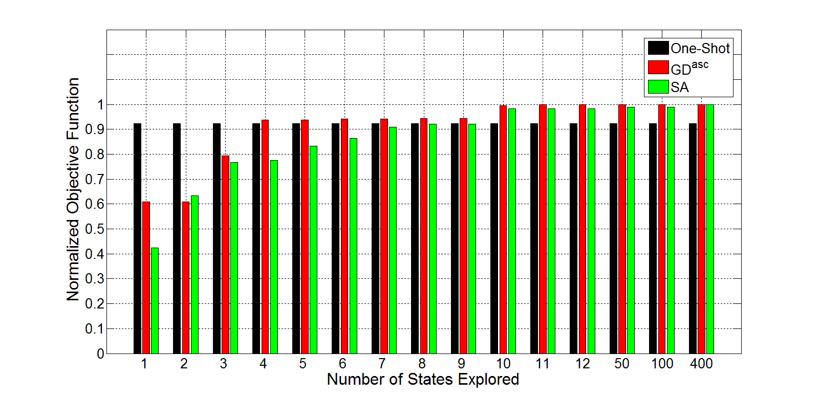
Results – Ambient Conditions Monitoring Application
GD and SA surpass One-Shot
One-Shot’s solution is within 8% of the optimal solution
Objective function value normalized to the optimal solution for a varying number of states explored for One-Shot, greedy, and SA algorithms for an ambient conditions monitoring application where ω_{l}=0.4, ω_{t}=0.5, ω_{r}=0.1, |S| = 729.

Slide 28
Results – Data Memory and Execution Time
Data memory requirements for One-Shot and greedy- and SA-based optimizations
N: Number of tunable parameters
m: Number of application metrics
|S|: Design space cardinality
One-Shot requires 204% and 458% less memory on average as compared to greedy- and SA-based design space exploration
Execution time for One-Shot and greedy- and SA-based dynamic optimizations
One-Shot solution requires 18% less execution time on average as compared to greedy- and SA-based dynamic optimizations
|S| | (N, m) | One-Shot | (N, m) | One-Shot
729; 31,104 | (3, 2) | 150 B | (6, 3) | 248 B
729; 31,104 | (3, 3) | 188 B | (6, 6) | 416 B
|S| | GD | SA
8 | 458 B | 514 B
81 | 528 B | 582 B
729 | 574 B | 624 B
31,104 | 870 B | 920 B
46,656 | 886 B | 936 B
ES: Exhaustive Search
|S| | One-Shot | GD (after 10 states) | SA (after 10 states) | ES
729 | 1.66 ms | 0.887 ms | 2.76 ms | 29.526 ms
31,104 | 1.66 ms | 1.33 ms | 2.88 ms | 2.765 s

Slide 29
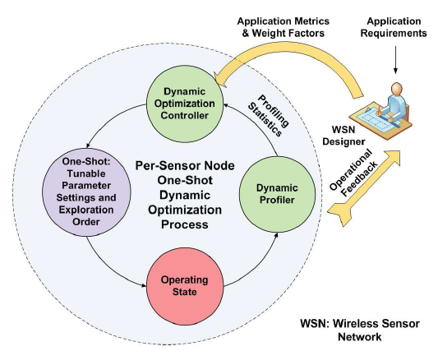
Conclusions
We proposed One-Shot – a dynamic optimization methodology for highly constrained WSNs that provides a high-quality operating state using intelligent initial tunable parameter value settings
We proposed an application metric estimation
model that is leveraged by One-Shot to estimate
high-level metrics from sensor node parameters
The percentage improvement attained by One-Shot
over other initial parameter settings was as high
as 155%
One-Shot solution was within 6% of the optimal
solution on average
One-Shot used 204% and 458% less memory as compared to the greedy- and SA-based methodologies
One-Shot required 18% less execution time on average as compared to the greedy- and SA-based methodologies

