Slide 1

Pursuing an Academic Position in ECE
Ann Gordon-Ross
Associate Professor
Department of Electrical and Computer Engineering
University of Florida

Slide 2
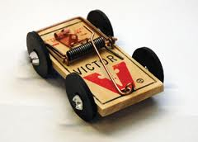




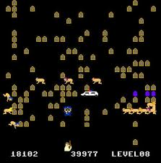
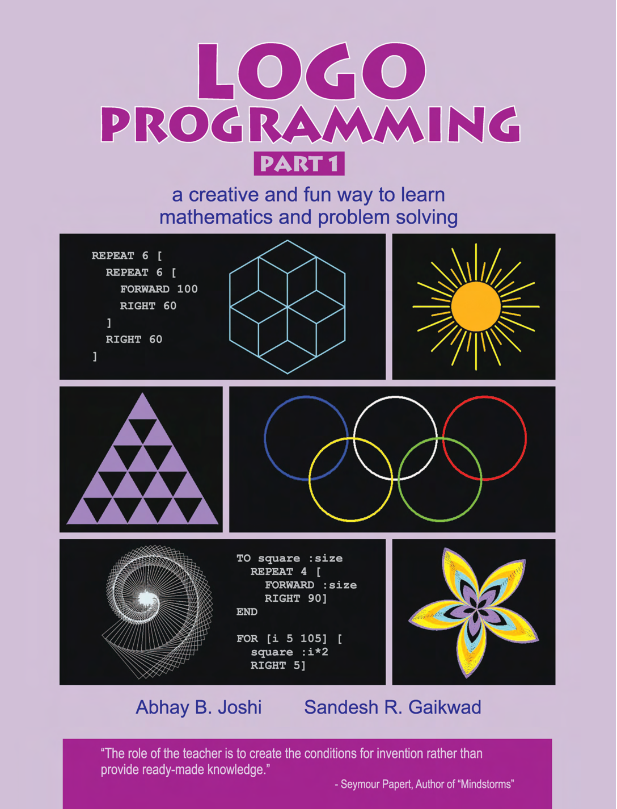






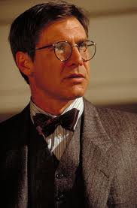


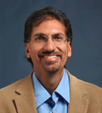


Accidental Path to Academia
Logo
Basic
forward 50
right 90
forward 50
High School
Programming course
Advanced placement
Math and science
*
$80k/year job?
Ph.D.?
M.S.?
B.S.
Graduate school?
* But I never wanted to be a teacher!

Slide 3
A Career Path to Academia
Goal one: securing an academic position
  Difficult: few positions, many applicants
  Must decide early in PhD studies since publishing is a MUST
  Difficult to return to academia after industry position
    Essentially no publishing while in industry
Goal two: attaining tenure
  Difficult: publish, publish publish!
  Secure funding
  Advise students
  Teach classes
Goal three: enjoying your job!
  Challenging but rewarding
  Helping your students to succeed
  Flexibility in schedule and research directions
Reality - Academia is not for everyone

